Slide 1

Simulating
the Energy Spectrum of
Quantum Dots
J. Planelles

Slide 2
PROBLEM 1. Calculate the electron energy spectrum of a 1D GaAs/AlGaAs QD as a function of the size.
Hint: consider GaAs effective mass all over the structure.
L
AlGaAs
AlGaAs
0.25 eV
GaAs
m*_{GaAs} = 0.05 m₀

Slide 3
The single-band effective mass equation:
Let us use atomic units (ħ=m₀=e=1)
Lb
L
Lb
V(x)
0.25 eV
BC:
f(0)=0
f(L_{t})=0
m*_{GaAs} = 0.05 m₀

Slide 4
Numerical integration of the differential equation: finite differences
Discretization grid
f₁
f₂
...
f_{n}
x₁
x₂
...
x_{n}
How do we approximate the derivatives at each point?
f_{i+1}
f_{i}
f_{i-1}
i-1
i
i+1
Step of the grid
h
h

Slide 5
FINITE DIFFERENCES METHOD
∞
∞
1. Define discretization grid
2. Discretize the equation:
0
h
L_{t}
3. Group coefficients of fwd/center/bwd points
i=1
i=n
i=2

Slide 6
i=1
i=2
i=n
Trivial eqs: f₁ = 0, f_{n} = 0.
0
Extreme eqs:
0
Matriz (n-2) x (n-2) - sparse
We now have a standard diagonalization problem (dim n-2):

Slide 7
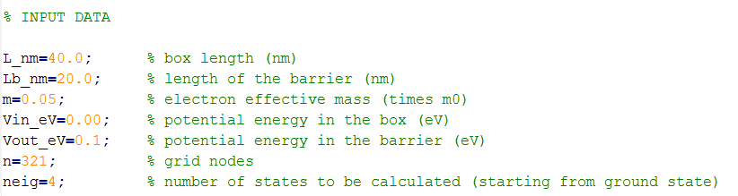
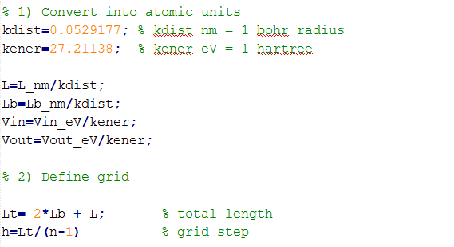

Slide 8
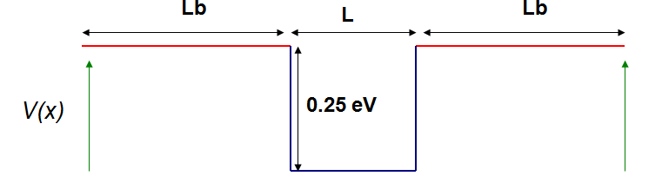
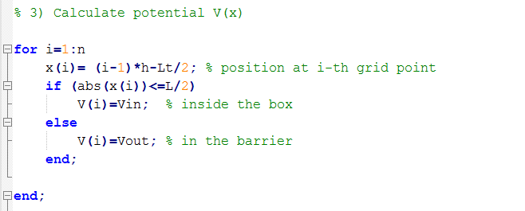
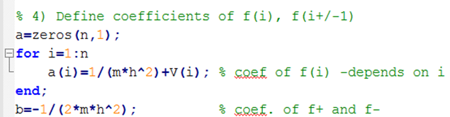
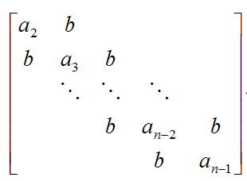

Slide 9
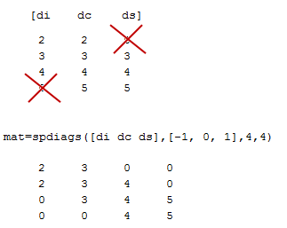
β ₂ | a₂ | 0
β ₃ | a₃ | b₃
... | ... | b₄
... | ... | ...
... | ... | ...
β _{n-2} | a _{n-2} | b_{n-2}
0 | a_{(n-1)} | b_{n-1}

Slide 10
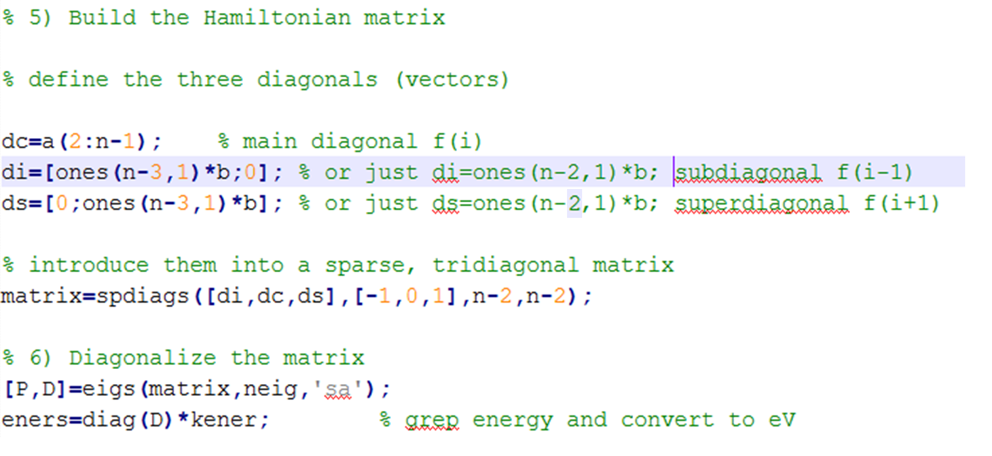
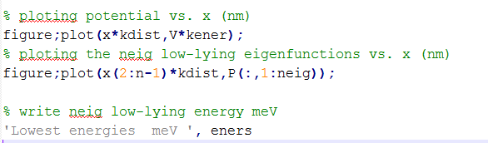

Slide 11
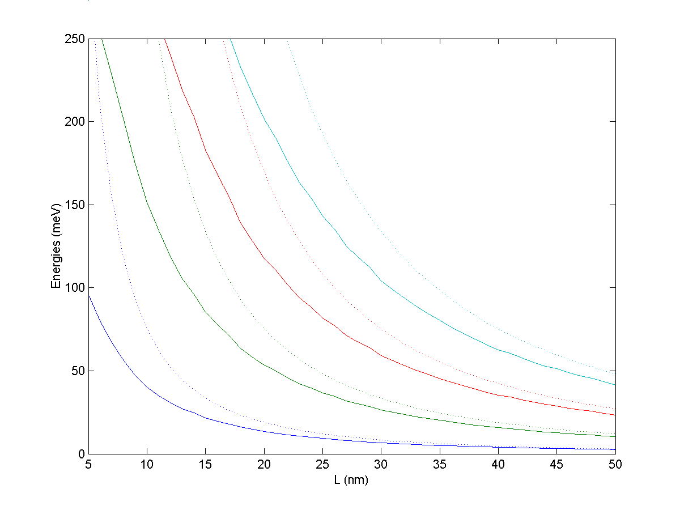
The result should look like this:
finite wall
n=4
infinite wall
n=3
n=2
n=1

Slide 12
Exercices:
Compare the converged energies with those of the particle-in-the-box with infinite walls for the n=1,2,3 states.
Plot the 3 lowest eigenstates for L=15 nm, L_{b}=10 nm. What is different from the infinite wall eigenstates?
HOME WORK:
Calculate the electron energy spectrum of two coupled QDs as a function of their separation S. Plot the two lowest states for S=1 nm and S=10 nm.
L=10 nm
L=10 nm
AlGaAs
AlGaAs
S
GaAs
GaAs
x

Slide 13
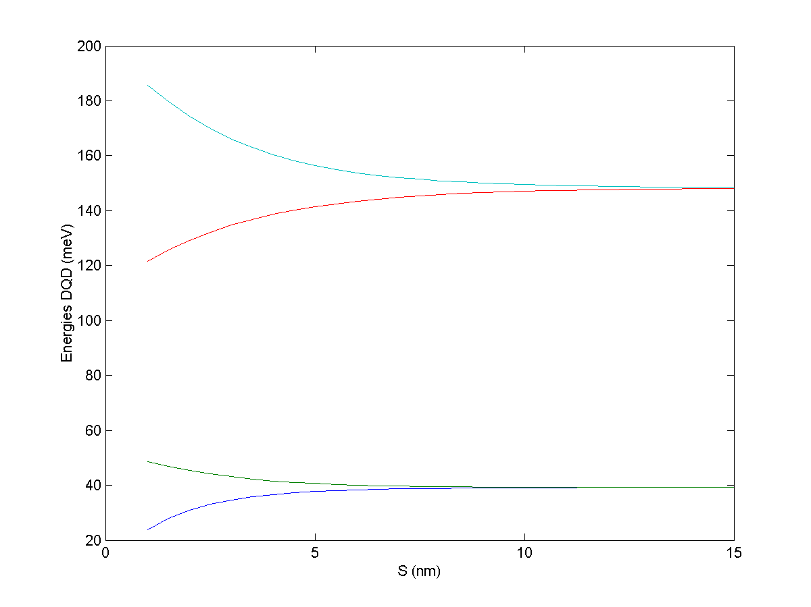
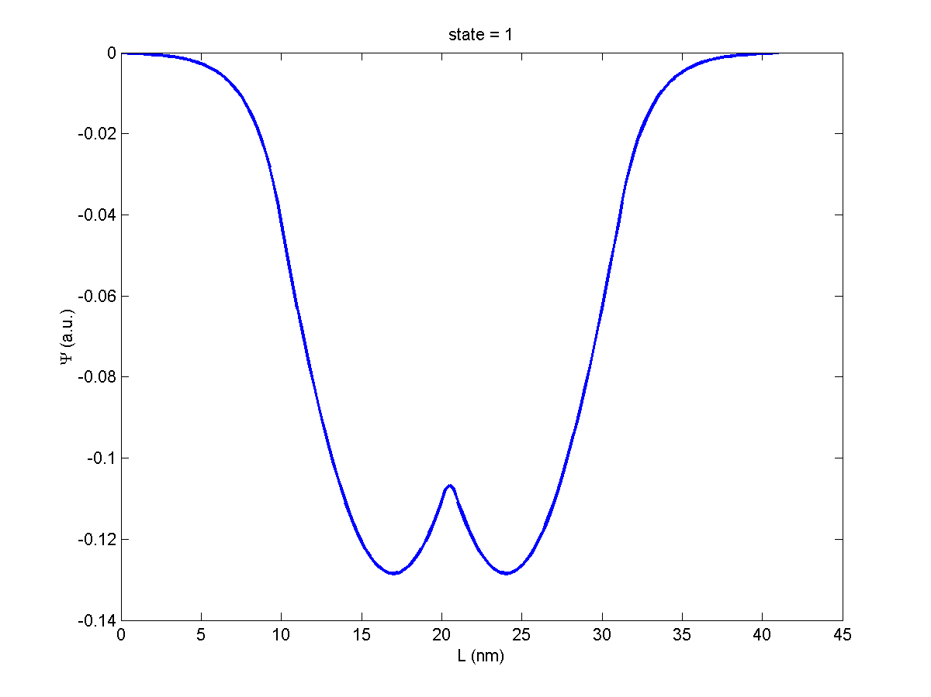
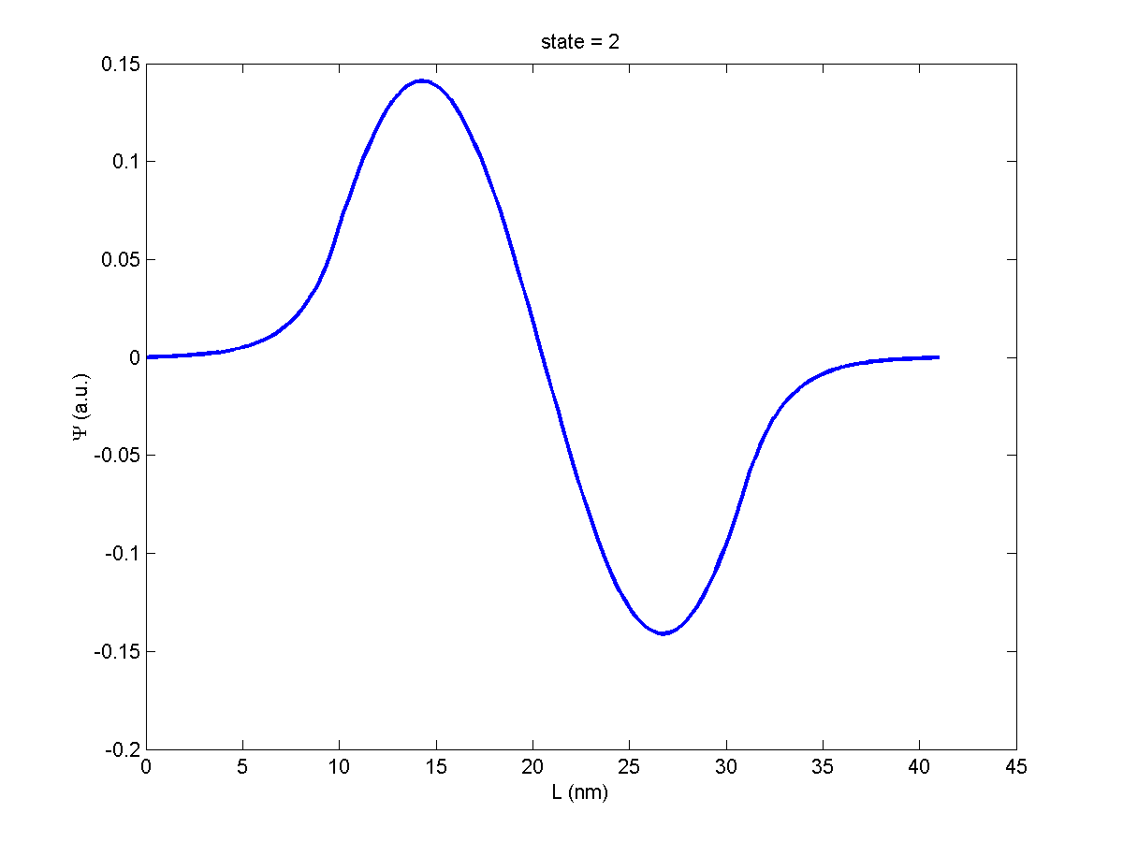
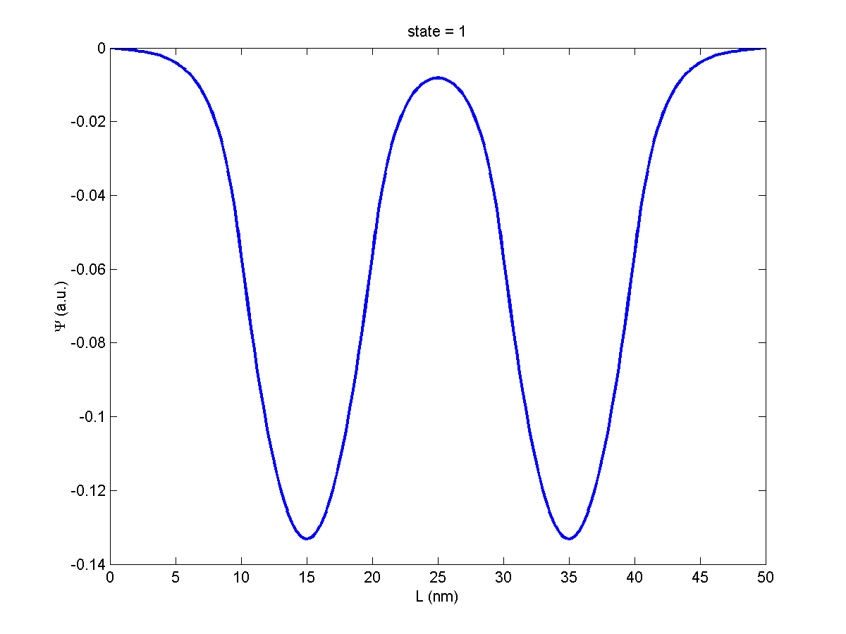
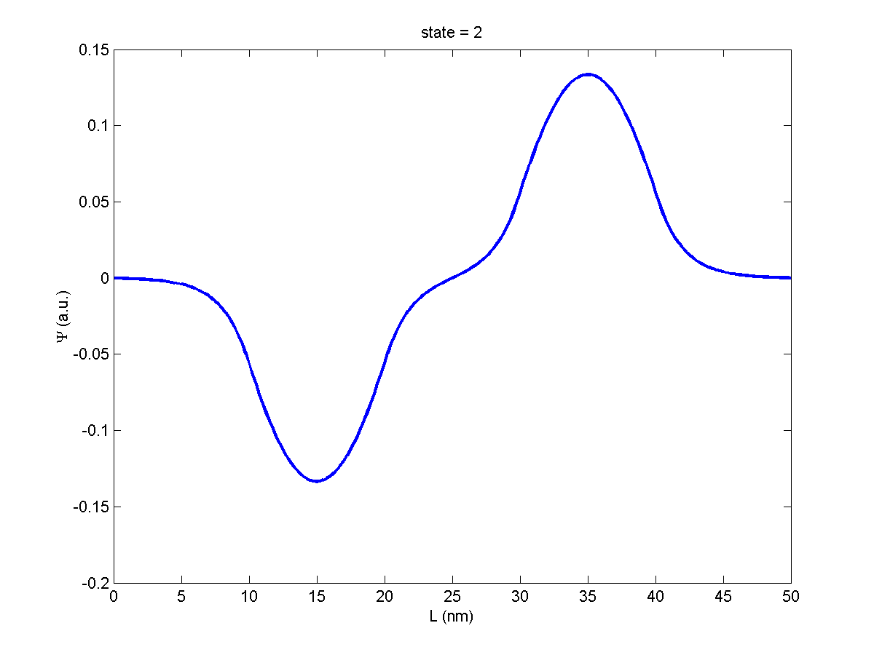
The result should look like this:
bonding
antibonding
bonding
antibonding

