Slide 1
In 1828 Wöhler excitedly reported to J. J. Berzelius, I must tell you that I can make urea without the use of kidneys, either man or dog. Ammonium cyanate is urea!
Organic compounds contain carbon and hydrogen or carbon and hydrogen in combination with a few other types of atoms, such as oxygen, nitrogen, and sulfur.
Carbon is singled out for special study because the ability of C atoms to form strong covalent bonds with one another allows them to join together into straight chains, branched chains and rings.
Methane CH₄

Slide 2
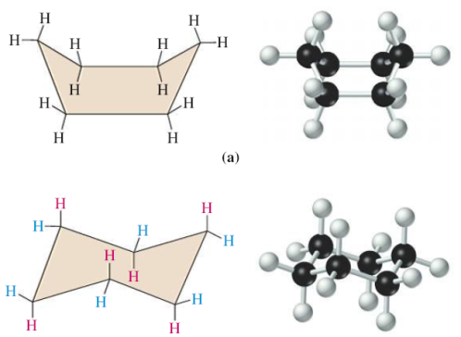
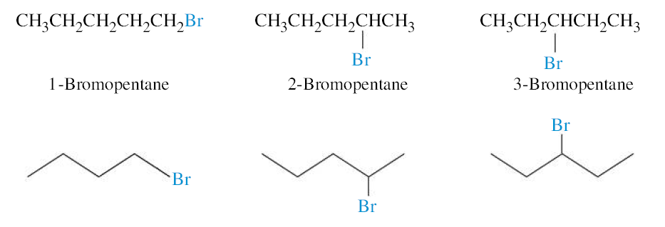
Hydrocarbons
Propane C₃H₈
Constitutional isomers
Cyclohexane
Functional Groups: Organic compounds typically contain elements in addition to carbon and
hydrogen. These groupings of one or several atoms called functional groups

Slide 3
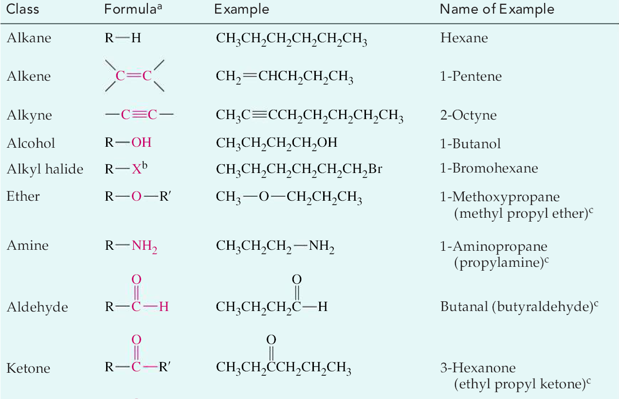

Slide 4
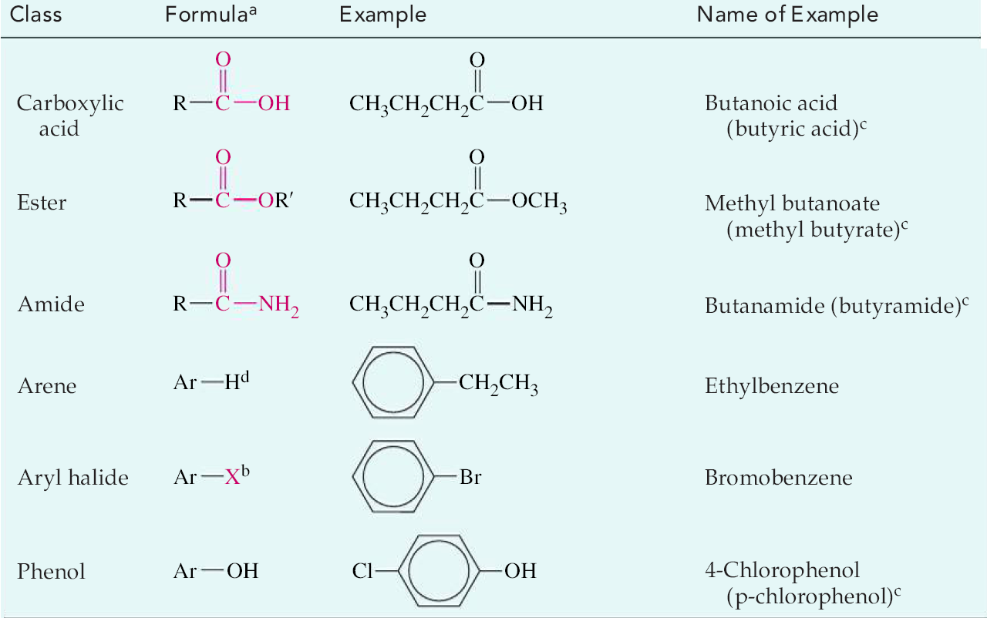

Slide 5
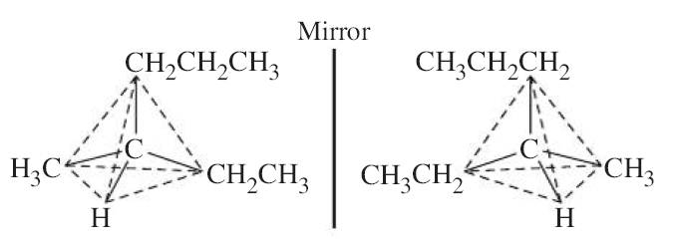
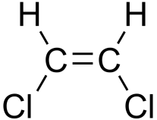
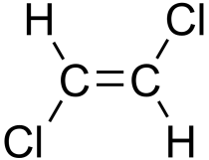
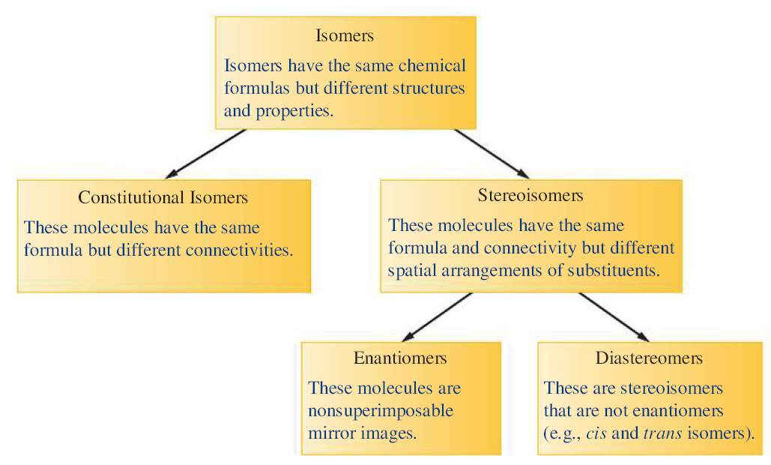
Stereoisomers
Enantiomers (chiral molecules)
Diastereomers

Slide 6
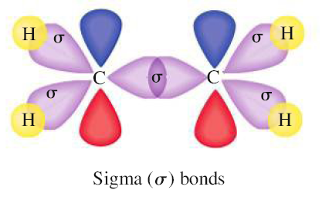
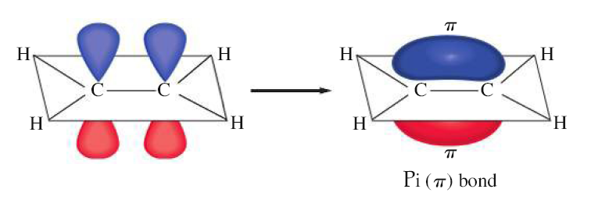

Slide 7
Aromatic hydrocarbons have ring structures with conjugated bonding system (a bonding scheme among the ring atoms that consists of alternating single and double bonds).

Slide 8
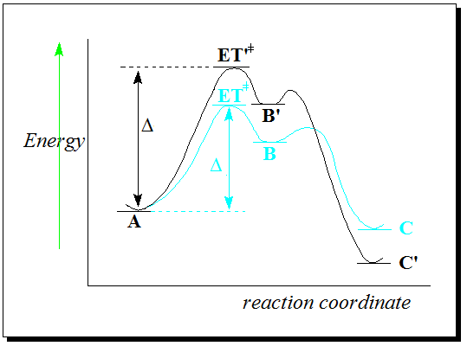
Kinetic and thermodynamic control of the reactions
Thermodynamic control: the most stable product (C’) is obtained.
Kinetic control: yields the product that comes up lower barriers (C).
Should we provide a lot of energy thermodynamic control is reached;
otherwise we will have kinetic control.
Example:

