Slide 1


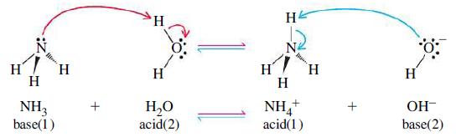
According to Bronsted-Lowry: acid is a proton donor
base is a proton acceptor
Rewriting Bronsted-Lowry: acid is compound having protons. The proton can share a pair of electrons of a base
base is compound having a pair of electrons willing to share them with a proton
an acid-base reaction is the transfer of a proton
Lewis claim: There are other acids than protons!

Slide 2
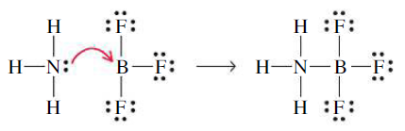
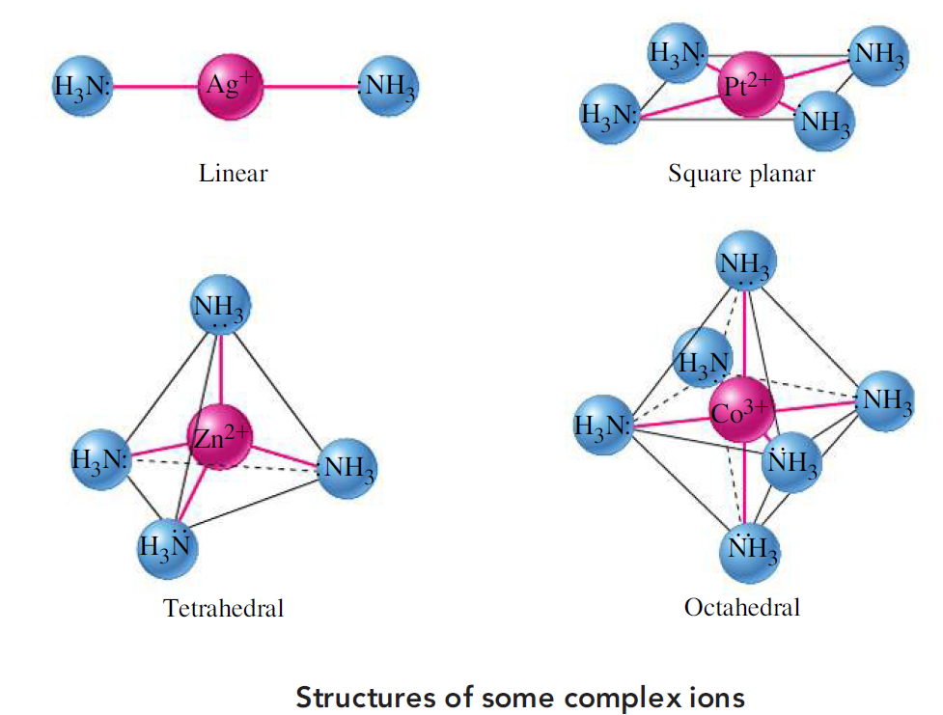
According to Lewis:
acid is compound having an atom willing to share a pair of electrons of a base
base is compound having a pair of electrons willing to share them with an acid
an acid-base reaction is
the sharing of a pair of
electrons

Slide 3
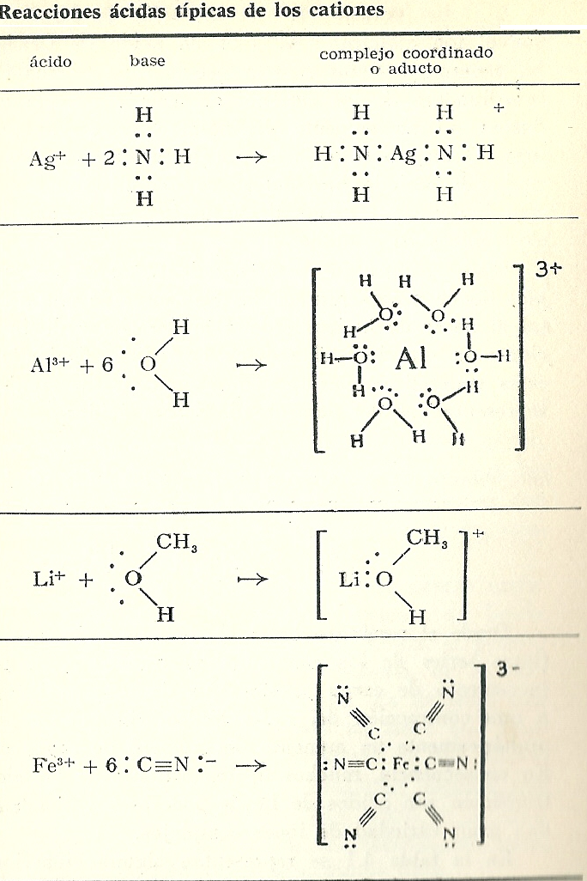
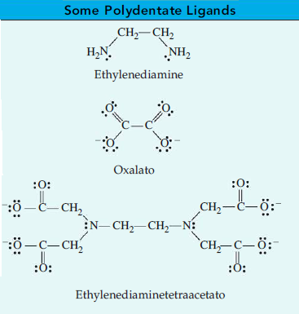
Complex equilibrium notation :
M (acceptor) + n L (donor) ⇄ ML_{n} (complex)
Lewis acid Lewis base complex
Ligands:
Monodentate: H₂O, NH₃, CO, NO …
Polydentate:

Slide 4
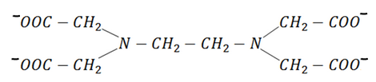
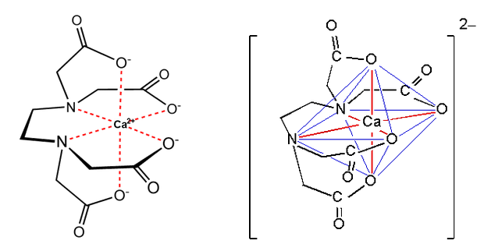
Chelate: a class of complex compounds consisting of a central metal atom attached to a large molecule (ligand) in a cyclic or ring-like structure.

Slide 5
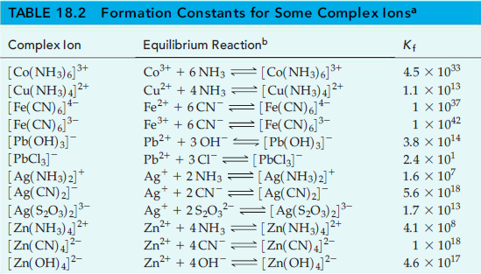

Slide 6
Cumulative formation constants
m=[M]
l =[L]

