Slide 1

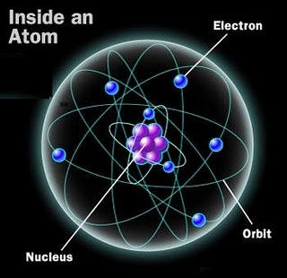
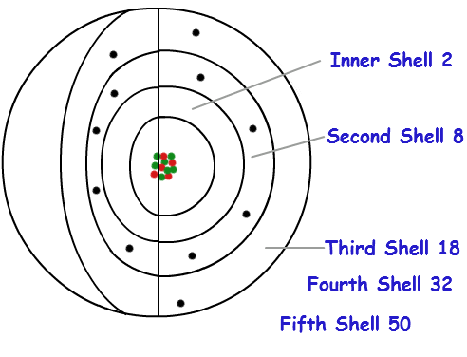
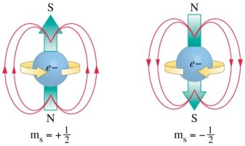
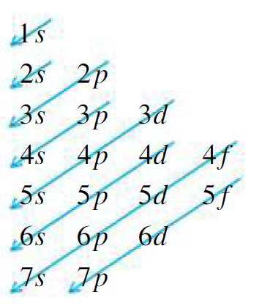
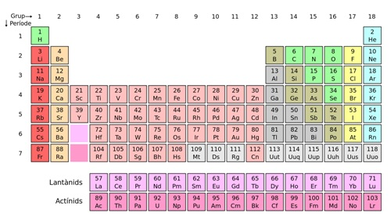
Atomic electron distribution
Shell: n=1, 2, 3, 4......
Sub-Shell: l=0, 1, 2, 3,... (n-1)
s p d f .....
Orbital: m= −l, .... 0 .... l
Spin: ms = + or −
Sequence: s s p s p s d p s d p s f d p ...
2 8 8 18 18 32 ...
2 10 18 36 54 86 ....

Slide 2
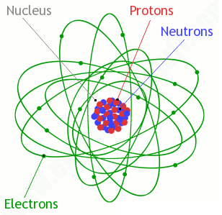
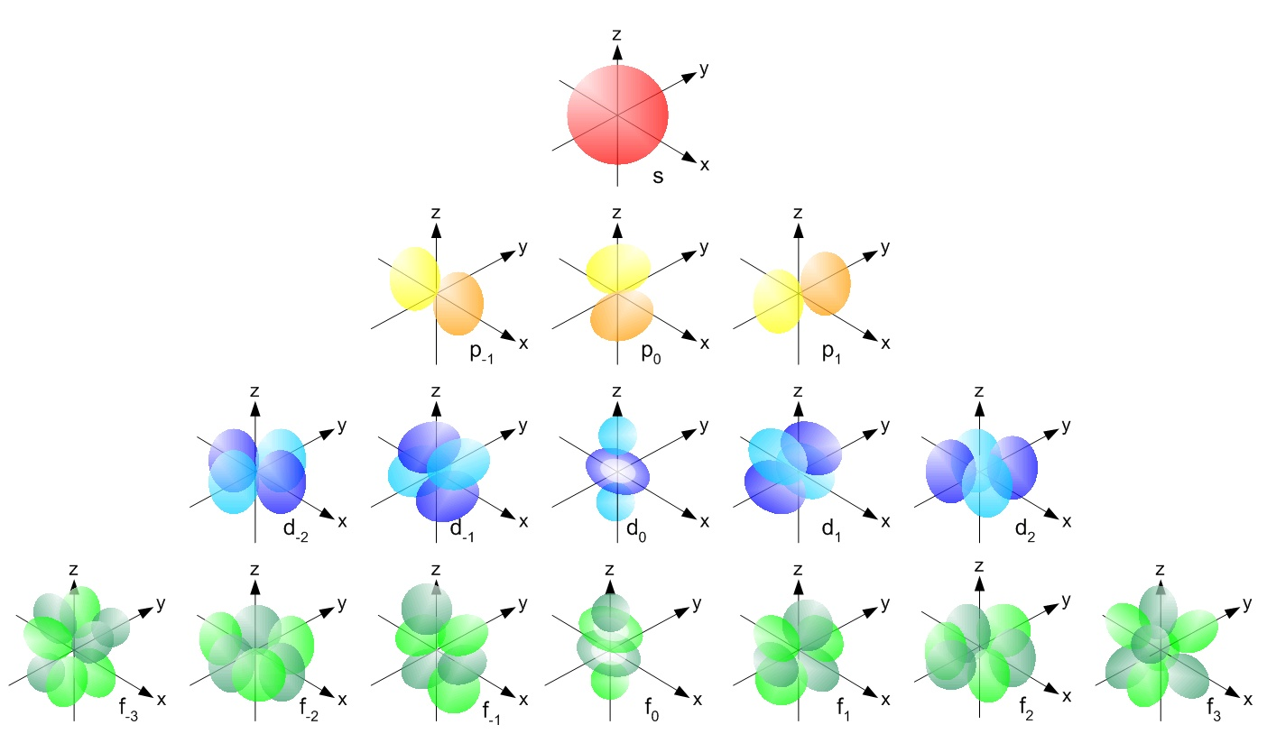
Orbitals are not planetary orbits!

Slide 3

s s p s p s d p s d p s f d p ...
2 8 8 18 18 32 ...
2 10 18 36 54 86 ....
Ru (N=44) 44-36= 8 5s² 4d⁶
As (N=33) 33-18= 15 4s² 3d¹⁰ 4p³
Anomalous configurations: filling or half-filling shells
e.g. Cu (N=29) 29-18= 11 4s¹ 3d¹⁰

Slide 4
Some definitions
Atom: An atom is the smallest constituent unit of ordinary matter that has the properties of a chemical element.
Chemical element: The chemical elements are pure substances that can not be decomposed into any other pure substance by simple chemical methods.
Molecule: A molecule is an electrically neutral group of two or more atoms held together by chemical bonds.
A molecule can be decomposed by chemical methods into other simpler pure substances.
Molecules are distinguished from ions by their lack of electrical charge.

Slide 5

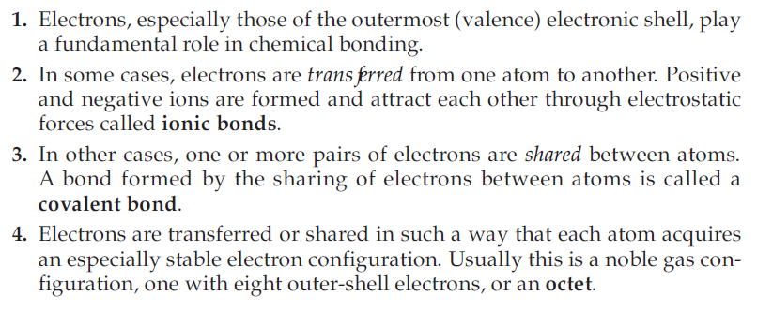

Slide 6
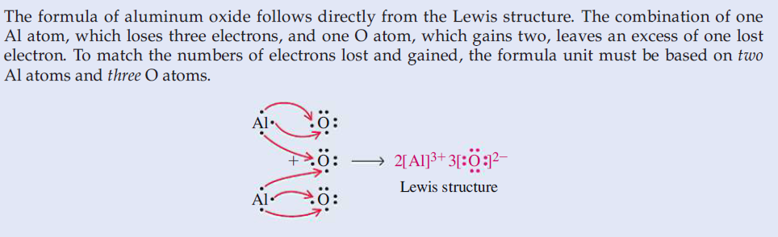





Slide 7







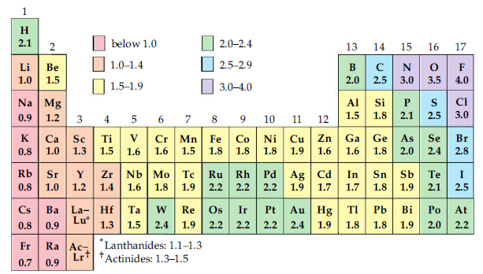

Slide 8

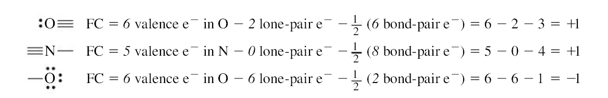
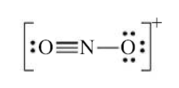
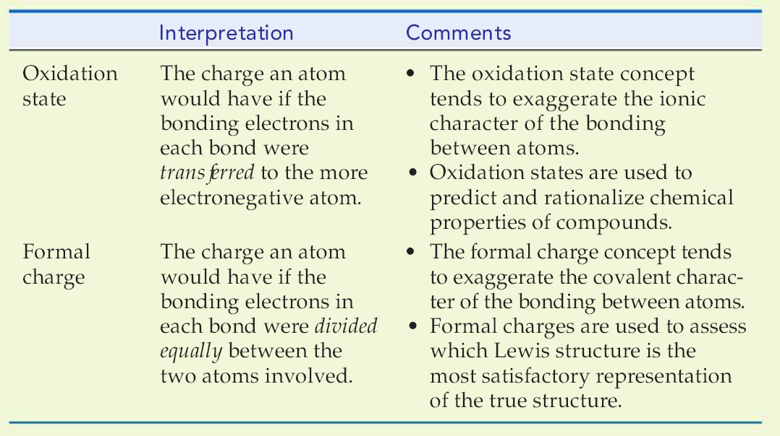

Slide 9
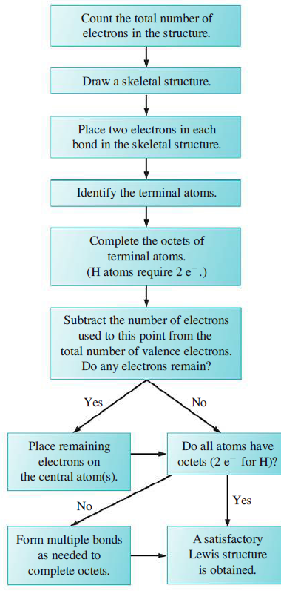

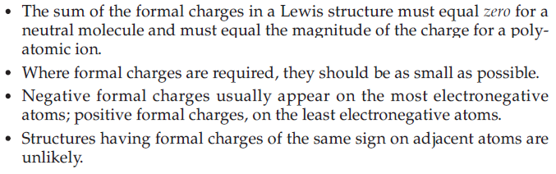





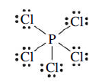

Slide 10


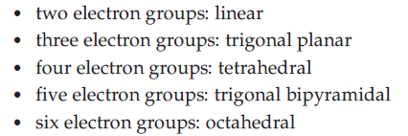
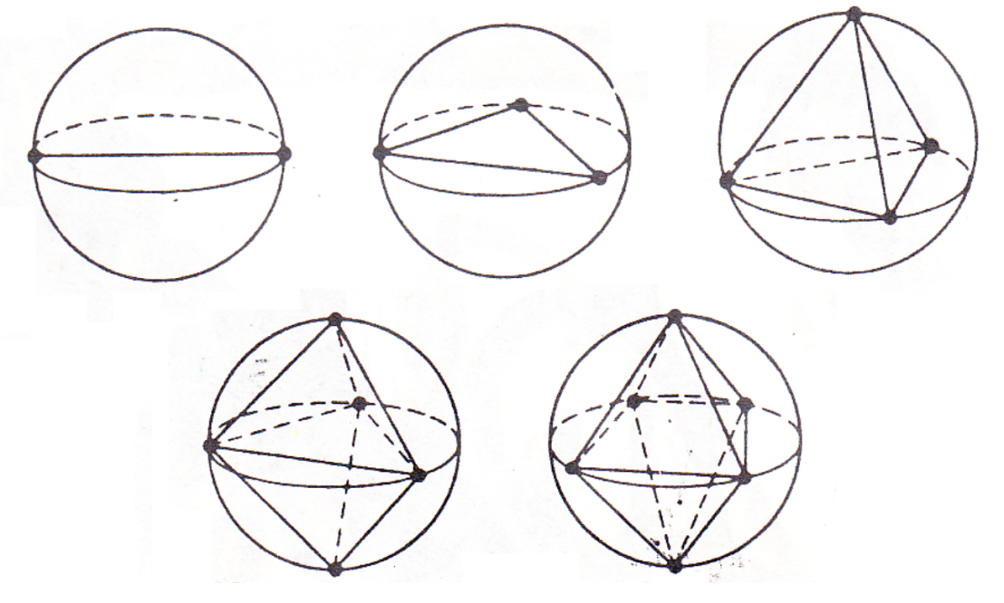

Slide 11
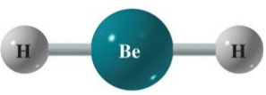
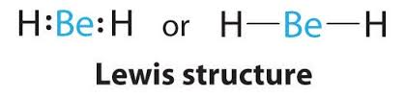
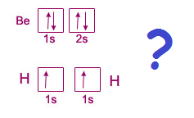
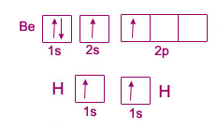
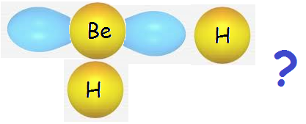
Hybrid orbitals and molecular geometry

Slide 12
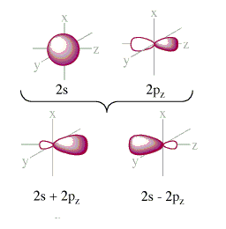

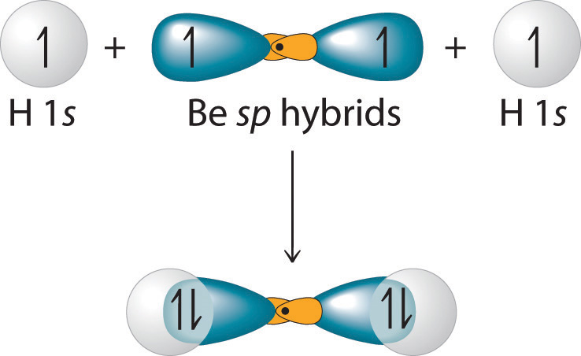
Hybrid orbitals (cont.)

Slide 13
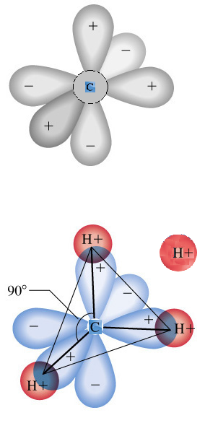
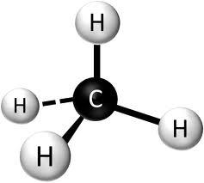
Hybrid orbitals (cont.) Methane case

Slide 14
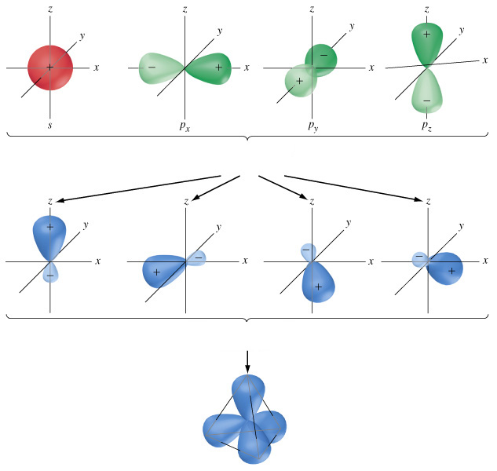
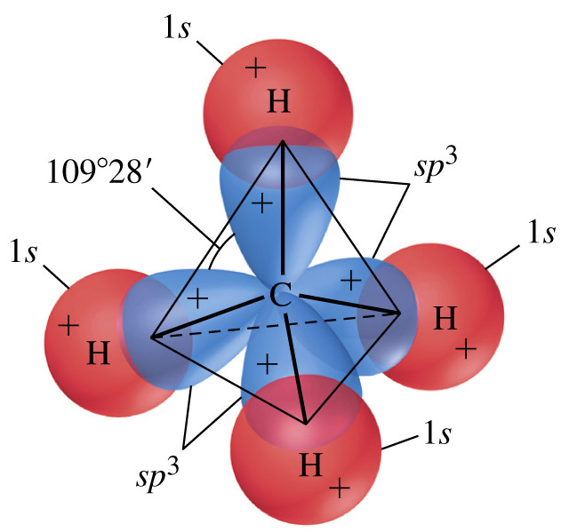

Slide 15
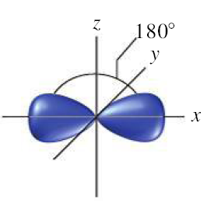
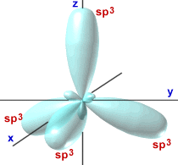
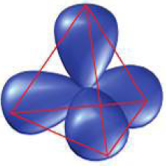

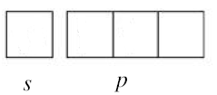

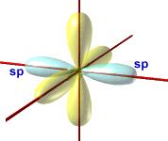
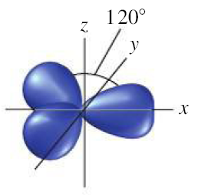
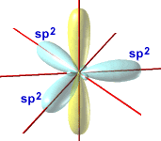


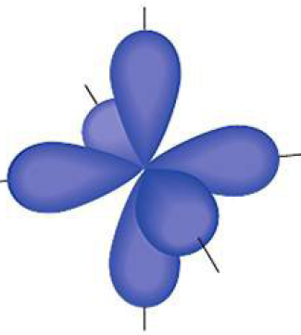




Slide 16
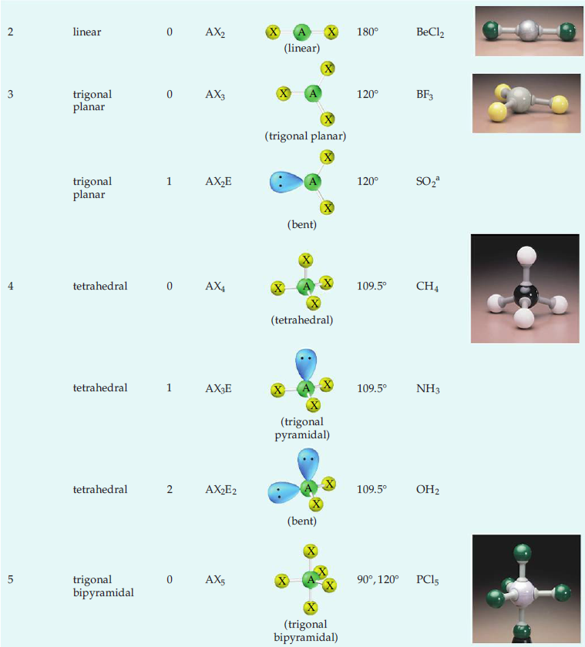

Slide 17
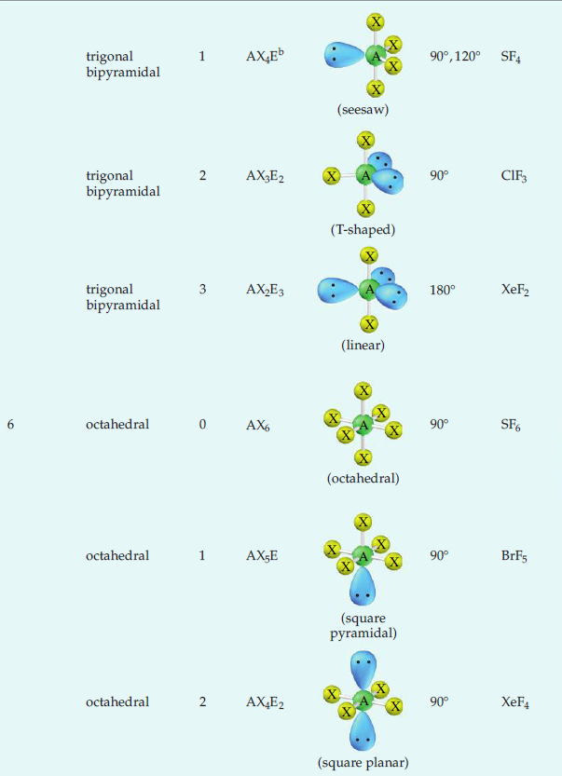

Slide 18

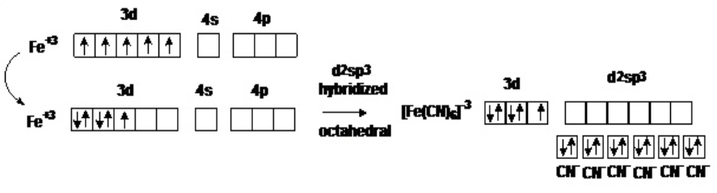
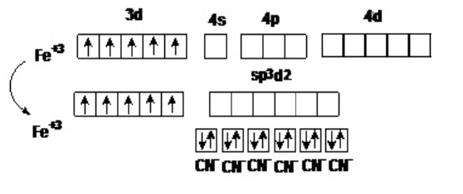
Further reading:
Inner shell Lone pairs of electrons are ignored. Since lone pairs are in the inner shell, they are believed to have little effect on molecular geometry
Octahedral
[Fe(CN)₆]³⁻
Octahedral

Slide 19

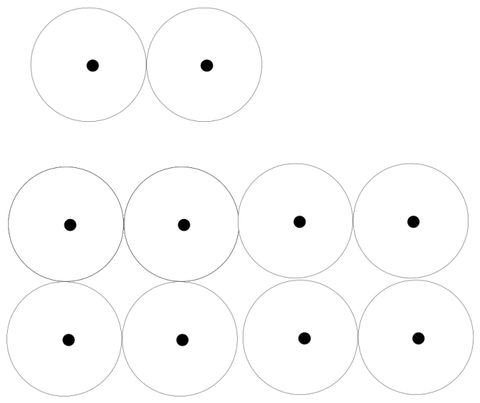

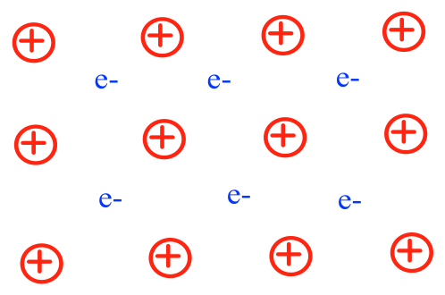

Na [Ne] 3s¹
Na₂
Na_{n}

Slide 20
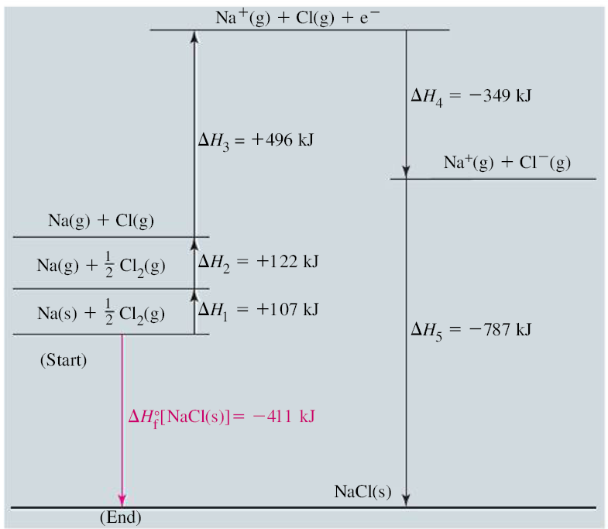
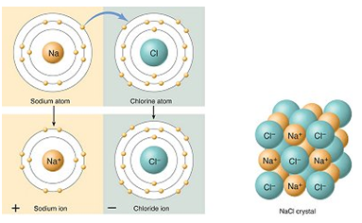


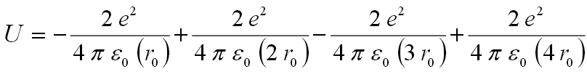
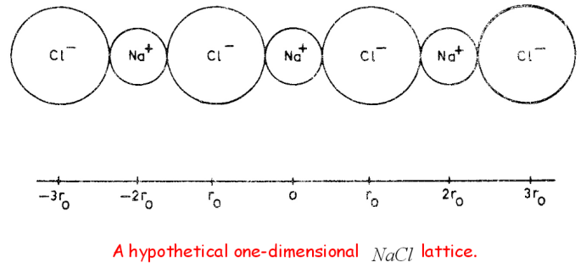


(lattice energy U)
Repulsion correction

Slide 21
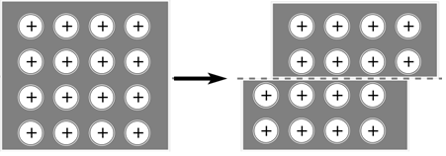
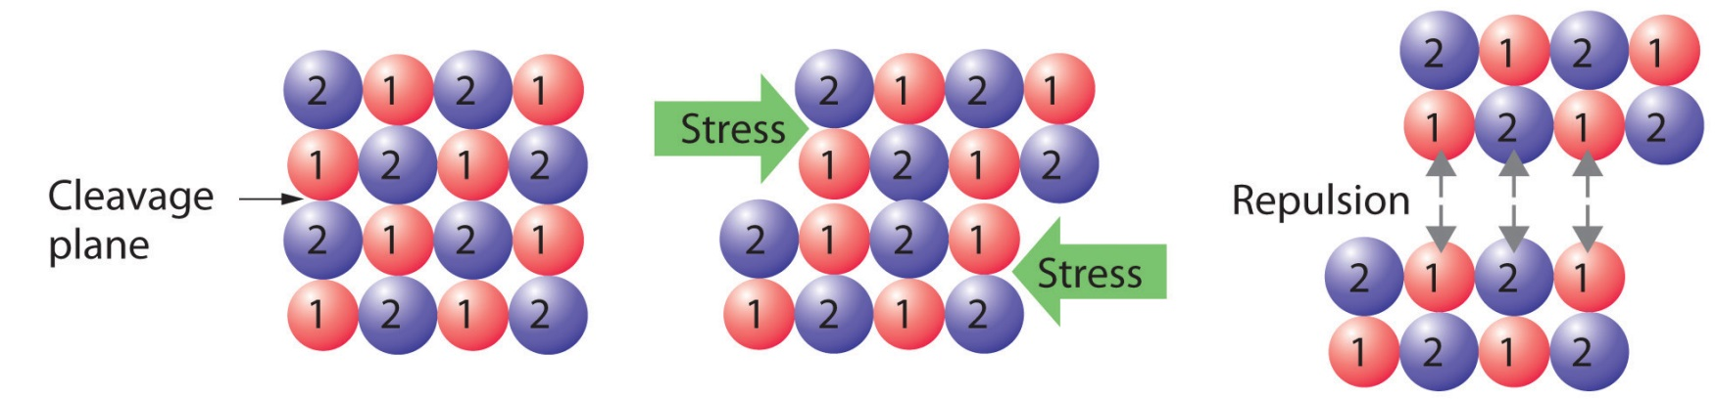
Metal crystal: ductile and malleable
Ionic crystal: hard but brittle

Slide 22
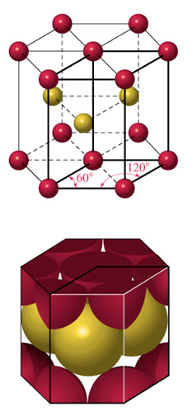





Arranging atoms or ions in solids

Slide 23



If the atoms are identical and are bound together mainly by dispersion forces which are completely non-directional, they will favor a structure in which as many atoms can be in direct contact as possible. This will, of course, be the hexagonal arrangement. However ….

Slide 24





