Slide 1
Hamiltonians topològics: vistos des de la química
Josep Planelles

Slide 2
C. Segarra, J. Planelles and S. Ulloa
"Edge states in dichalcogenide nanoribbons and triangular quantum dots"
Phys. Rev. B 93, 085312.1-6 (2016)
C. Segarra, J.Planelles and J.I. Climente
"Magnetic field dependence of edge states in MoS2 quantum dots“, 2018
Chapter 17 of "Physics of Quantum Rings" (Springer, ed. V. Fomin), 2nd edition
J.Planelles
"A brief note in the form of a decalogue about Berry phase, Chern number, curvature, topological Hamiltonians and much more ... an outline for beginners“
Research Gate 2018 DOI: 10.13140/RG.2.2.13602.73923
Pleiade d’autors,
Optimized cation exchange for mercury chalcogenides 2D nanoplatelets and its application for alloys
just submitted
5.1b De Born-Oppenheimer als hamiltonians topològics
youtube
5.1c Del radical al.lil als hamiltonians topològics

Slide 3

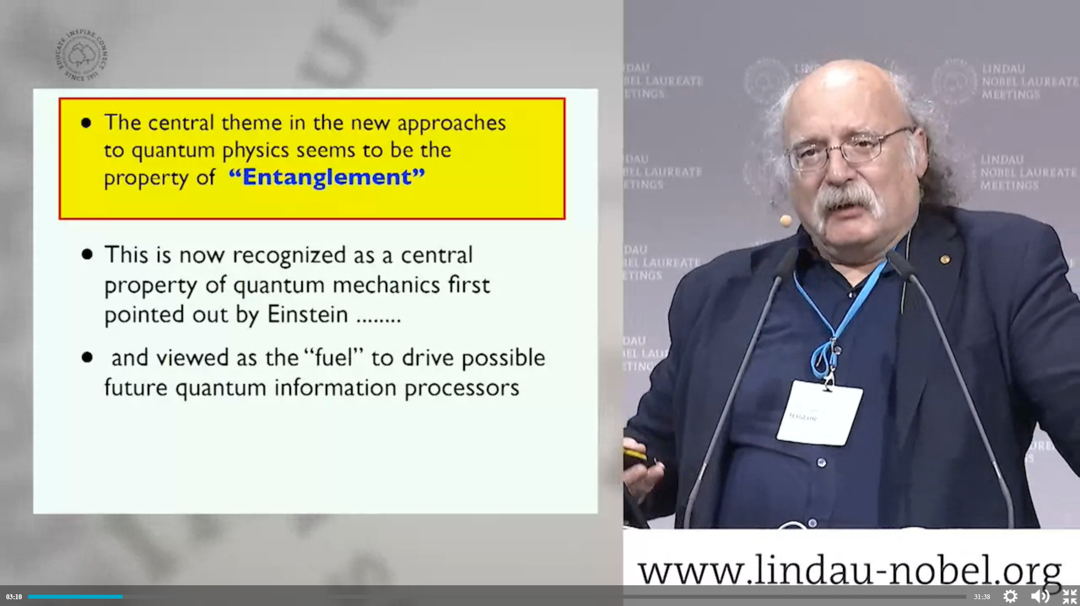
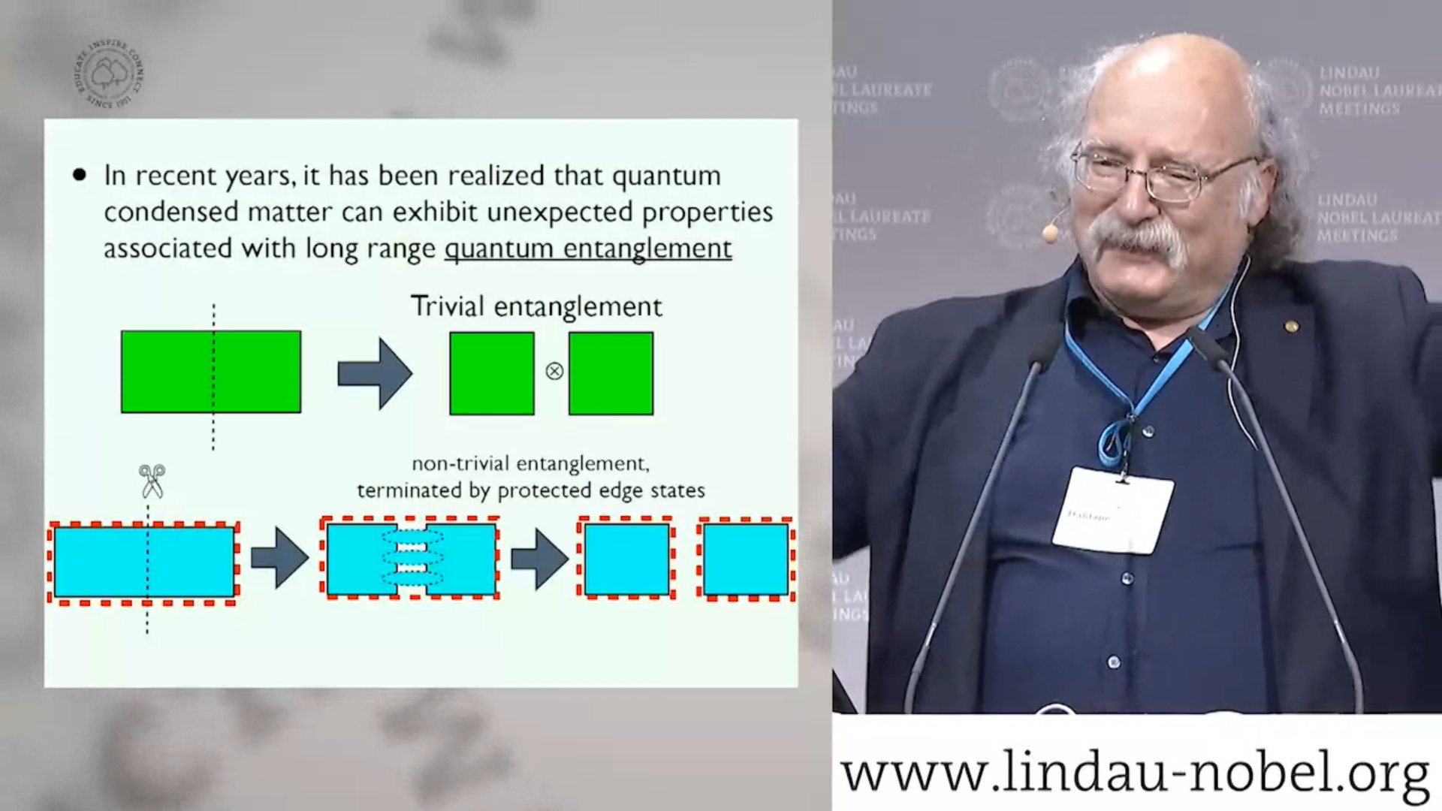
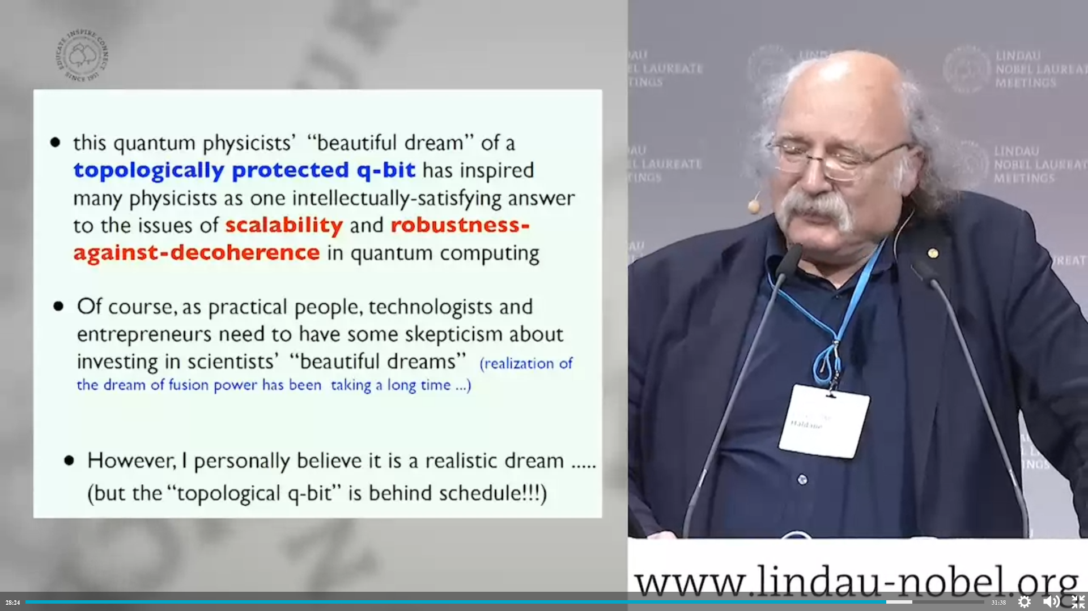
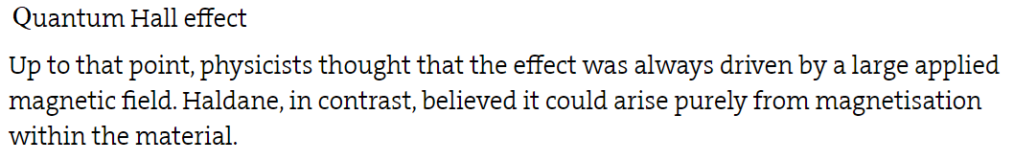
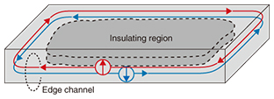

Slide 4
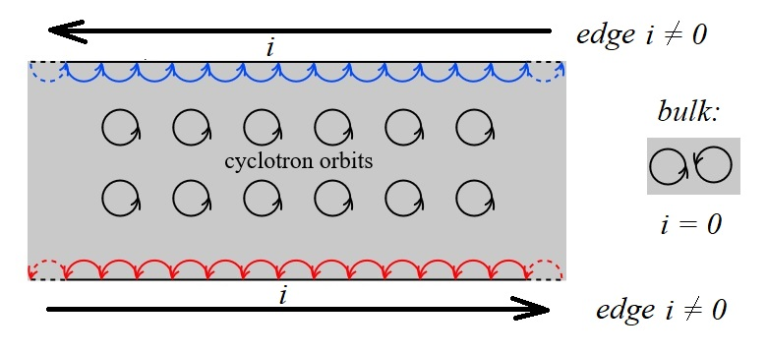
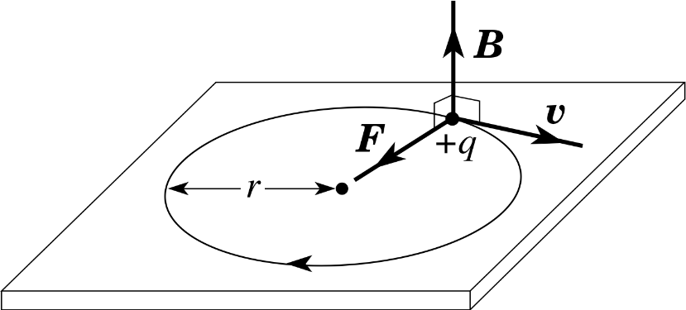

Slide 5
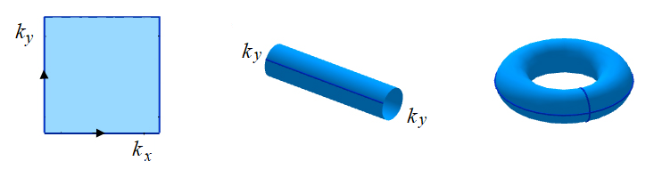
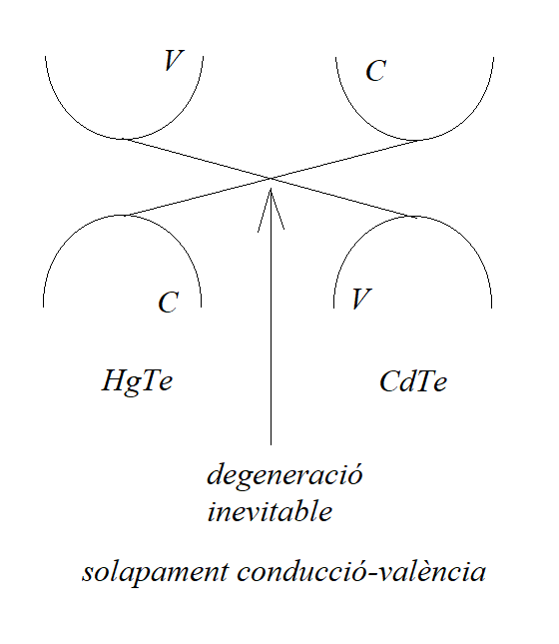


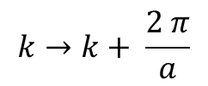
$$A_{k}=i 〈u_{nk}\left(\vec{r}\right) | ∇_{k}|u_{nk}\left(\vec{r}\right)〉$$
$$Ψ_{nk}\left(\vec{r}\right)=u_{n}\left(\vec{r}\right){ e}^{i\vec{k}\vec{r}}$$
connexió de Berry, anàleg de potencial vector
$$k→k+ \frac{2 π}{a}$$
més detalls en la serie: 5.1b De Born-Oppenheimer
als hamiltonians topològics

Slide 6
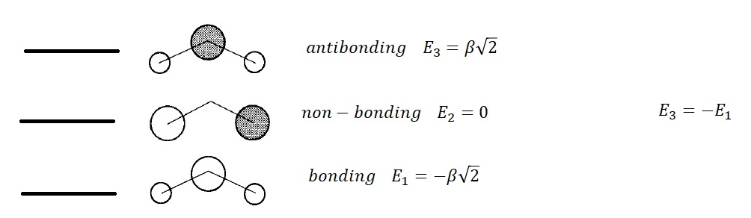

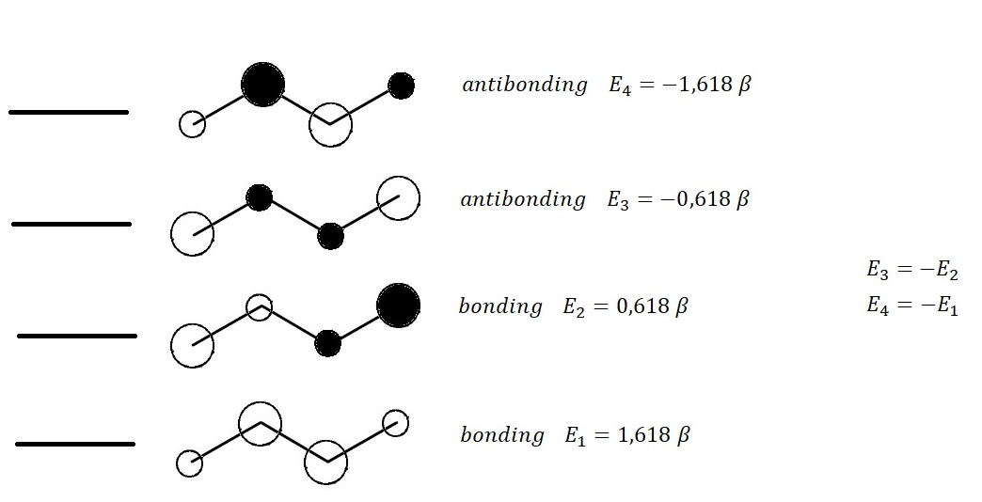

Hamiltonians Topològics 1D

Slide 7
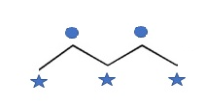




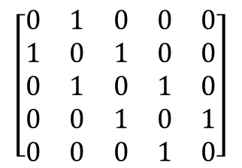




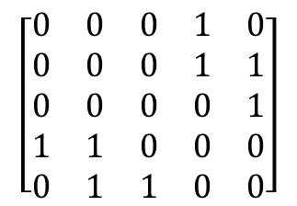





$$\left[\begin{matrix}0 & 1 & 0 & 0 & 0 \\ 1 & 0 & 1 & 0 & 0 \\ 0 & 1 & 0 & 1 & 0 \\ 0 & 0 & 1 & 0 & 1 \\ 0 & 0 & 0 & 1 & 0\end{matrix}\right]$$
$$\left[\begin{matrix}0 & 0 & 0 & 1 & 0 \\ 0 & 0 & 0 & 1 & 1 \\ 0 & 0 & 0 & 0 & 1 \\ 1 & 1 & 0 & 0 & 0 \\ 0 & 1 & 1 & 0 & 0\end{matrix}\right]$$
$$H=\left[\begin{matrix}𝕆 & 𝔸 \\ 𝔸^{t} & 𝕆\end{matrix}\right]$$
$$Γ=\left[\begin{matrix}𝕀 & 𝕆 \\ 𝕆 & −𝕀\end{matrix}\right]$$
$$\left[\begin{matrix}𝕆 & 𝔸 \\ 𝔸^{t} & 𝕆\end{matrix}\right]\left[\begin{matrix}𝕀 & 𝕆 \\ 𝕆 & −𝕀\end{matrix}\right]=\left[\begin{matrix}𝕆 & −𝔸 \\ 𝔸^{t} & 𝕆\end{matrix}\right]$$
$$H Γ+Γ H=0$$
$$\left[\begin{matrix}𝕀 & 𝕆 \\ 𝕆 & −𝕀\end{matrix}\right]\left[\begin{matrix}𝕆 & 𝔸 \\ 𝔸^{t} & 𝕆\end{matrix}\right]=\left[\begin{matrix}𝕆 & 𝔸 \\ {−𝔸}^{t} & 𝕆\end{matrix}\right]$$
$$H Ψ=E Ψ$$
$$ΓΨ$$
$$−E$$
$$H Γ Ψ=−Γ H Ψ=−E Γ Ψ$$
$$E$$
$$−E$$

Slide 8



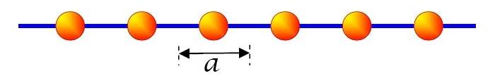
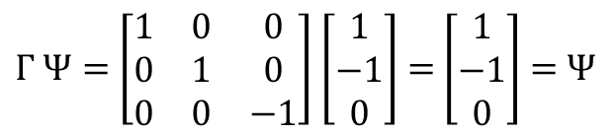

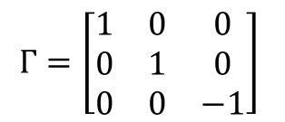


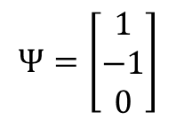


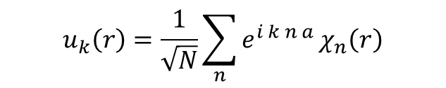
$$Ψ=\left[\begin{matrix}1 \\ −1 \\ 0\end{matrix}\right]$$
$$Γ=\left[\begin{matrix}1 & 0 & 0 \\ 0 & 1 & 0 \\ 0 & 0 & −1\end{matrix}\right]$$
$Γ Ψ=$ $\left[\begin{matrix}1 & 0 & 0 \\ 0 & 1 & 0 \\ 0 & 0 & −1\end{matrix}\right]$ $\left[\begin{matrix}1 \\ −1 \\ 0\end{matrix}\right]$ $=$ $\left[\begin{matrix}1 \\ −1 \\ 0\end{matrix}\right]$ $=$ $Ψ$
$${\hat{T}}_{N}$$
$$χ\left(r\right)$$
$${\hat{T}}_{N}χ\left(r\right)=χ\left(r+na\right)$$
$$u_{k}\left(r\right)=\frac{1}{\sqrt{N}}\sum_{n}{e^{i k n a}}χ_{n}\left(r\right)$$
$$χ_{n}\left(r\right)=χ\left(r−na+\frac{a}{2}\right)$$
$$k∈\left[−\frac{π}{a},\frac{π}{a}\right]$$

Slide 9
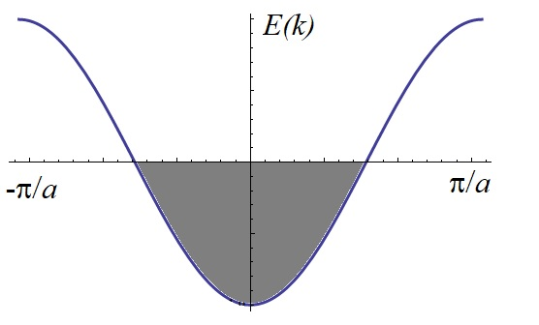
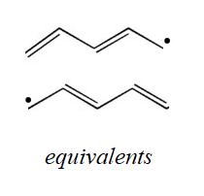
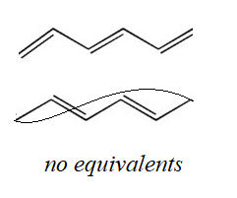
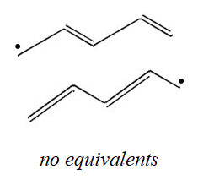





$$〈χ_{n}\left|H\right|χ_{n}〉=α≡0$$
$$E_{k}=〈u_{k}\left|H\right|u_{k}〉=\frac{1}{N}\sum_{n,m}{e^{i k (n−m) a}}〈χ_{n}\left|H\right|χ_{m}〉=\frac{1}{N}N\left(α+e^{i k a}β+e^{−i k a}β\right)$$
$$〈χ_{n}\left|H\right|χ_{n±1}〉=β$$
$$〈χ_{n}\left|H\right|χ_{m≠n±1}〉=0$$
$$E_{k}=2β cos ka$$
$$β<0$$

Slide 10

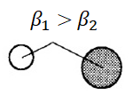

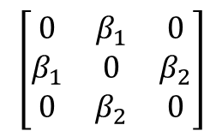






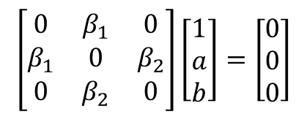
$$E=\sqrt{β_{1}^{2}+β_{2}^{2}}$$
$$\left[\begin{matrix}0 & β_{1} & 0 \\ β_{1} & 0 & β_{2} \\ 0 & β_{2} & 0\end{matrix}\right]$$
$$E\left(−E^{2}+\left(β_{1}^{2}+β_{2}^{2}\right)\right)=0$$
$$E=0$$
$$E=−\sqrt{β_{1}^{2}+β_{2}^{2}}$$
$$\left[\begin{matrix}0 & β_{1} & 0 \\ β_{1} & 0 & β_{2} \\ 0 & β_{2} & 0\end{matrix}\right]\left[\begin{matrix}1 \\ a \\ b\end{matrix}\right]=\left[\begin{matrix}0 \\ 0 \\ 0\end{matrix}\right]$$
$a$=0
$$E=0$$
$b$=− $β_{1}$/ $β_{2}$

Slide 11
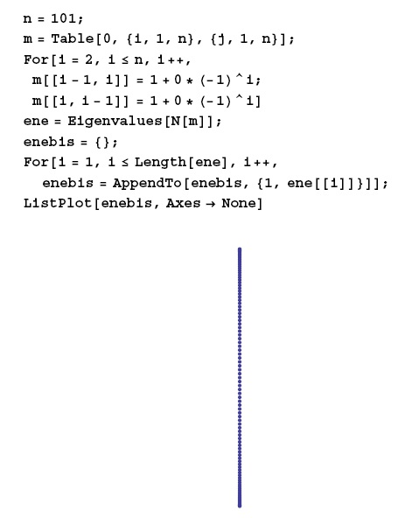
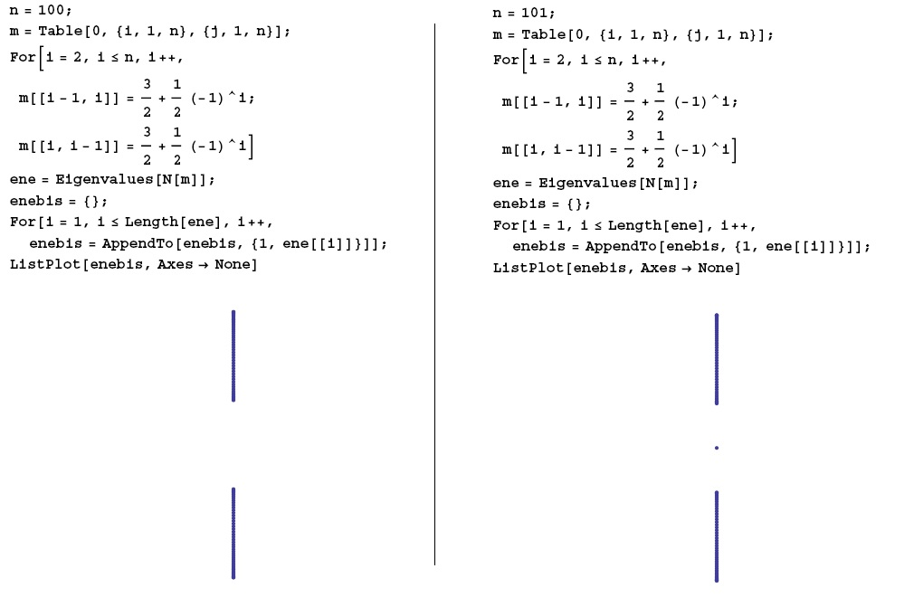

Slide 12
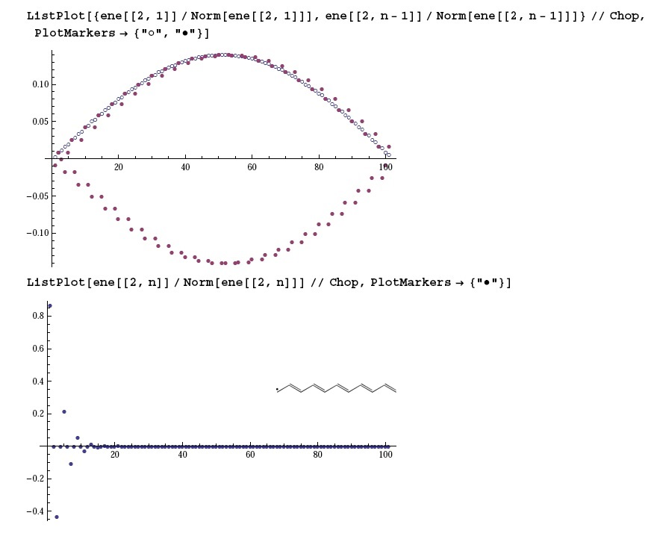
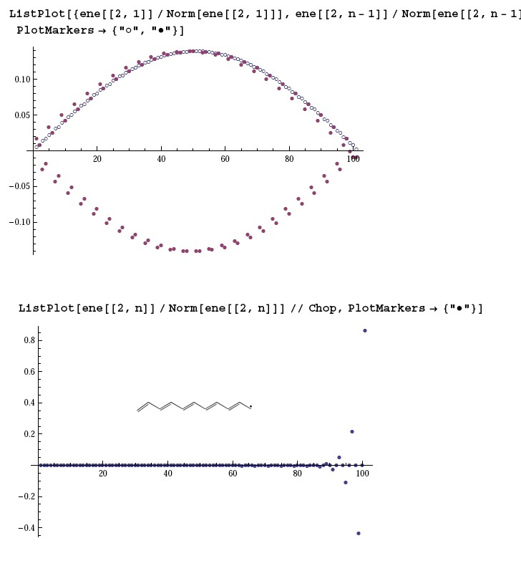

Slide 13
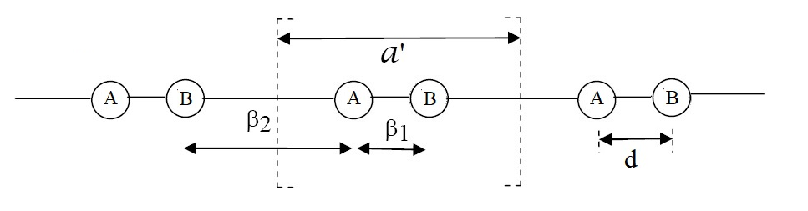

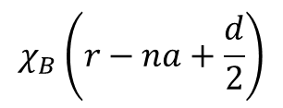

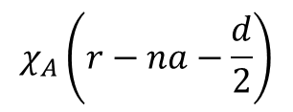
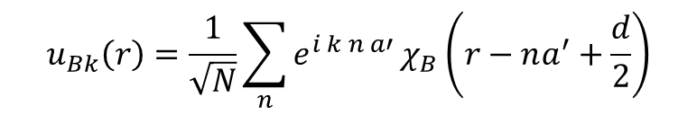
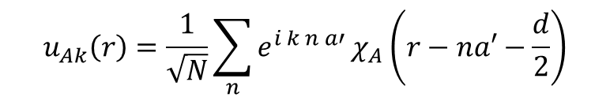

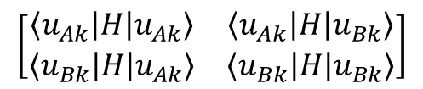
$$χ_{A}\left(r−na−\frac{d}{2}\right)$$
$$χ_{B}\left(r−na+\frac{d}{2}\right)$$
$$u_{Ak}\left(r\right)=\frac{1}{\sqrt{N}}\sum_{n}{e^{i k n a′}}χ_{A}\left(r−na′−\frac{d}{2}\right)$$
$$k∈\left[−\frac{π}{a′},\frac{π}{a′}\right]$$
$$u_{Bk}\left(r\right)=\frac{1}{\sqrt{N}}\sum_{n}{e^{i k n a′}}χ_{B}\left(r−na^{′}+\frac{d}{2}\right)$$
$$〈k\left|H\right|k′〉=0$$
$$\left[\begin{matrix}〈u_{Ak}\left|H\right|u_{Ak}〉 & 〈u_{Ak}\left|H\right|u_{Bk}〉 \\ 〈u_{Bk}\left|H\right|u_{Ak}〉 & 〈u_{Bk}\left|H\right|u_{Bk}〉\end{matrix}\right]$$
$$〈u_{Ak}\left|H\right|u_{Ak}〉=α≡0$$

Slide 14



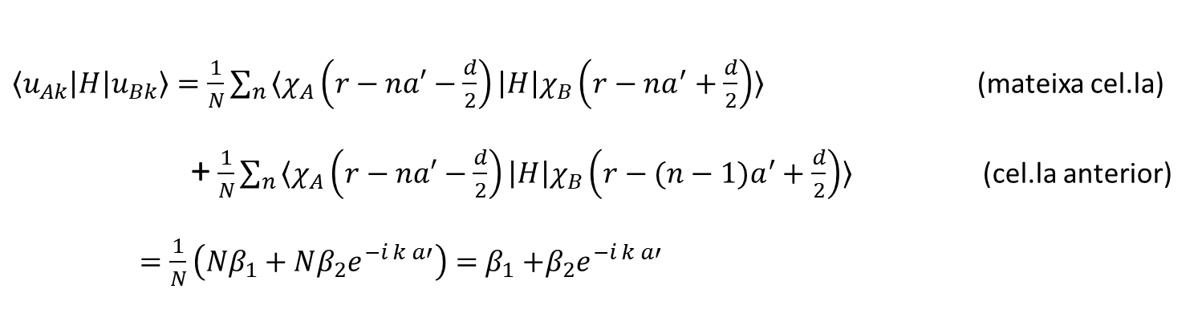
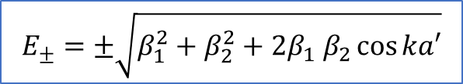

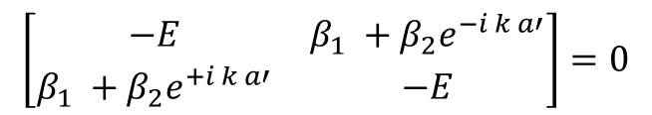

$〈u_{Ak}\left|H\right|u_{Bk}〉=\frac{1}{N}\sum_{n}{〈χ_{A}\left(r−na′−\frac{d}{2}\right)\left|H\right|χ_{B}\left(r−na^{′}+\frac{d}{2}\right)〉}$ (mateixa cel.la)
+ $\frac{1}{N}\sum_{n}{〈χ_{A}\left(r−na′−\frac{d}{2}\right)\left|H\right|χ_{B}\left(r−(n−1)a^{′}+\frac{d}{2}\right)〉}$ (cel.la anterior)
$=\frac{1}{N}\left(Nβ_{1}+Nβ_{2}e^{−i k a′}\right)=$ $β_{1}$ $+β_{2}e^{−i k a′}$
$〈u_{Ak}\left|H\right|u_{Bk}〉$ $=$ $β_{1}$ $+β_{2}e^{+i k a′}$
$E^{2}=\left(β_{1} +β_{2}e^{−i k a′}\right)$ $\left(β_{1} +β_{2}e^{+i k a′}\right)$
$$\left[\begin{matrix}−E & β_{1} +β_{2}e^{−i k a′} \\ β_{1} +β_{2}e^{+i k a′} & −E\end{matrix}\right]=0$$
$$E_{±}=±\sqrt{β_{1}^{2}+β_{2}^{2}+2β_{1} β_{2}\cos{ka′}}$$
$$β_{1}\text{=}β_{2}$$
$$a^{′}=2 a$$
$\cos^{2}{ka=\frac{1+\cos{ka′}}{2}→}$ $\cos{ka^{′}={2cos}^{2}ka−1}$
$$E_{±}=±\sqrt{2β^{2}+2β^{2}({2cos}^{2}ka−1)}=2β\cos{ka}$$
(resultat obtingut adès per a l’al.lil)

Slide 15
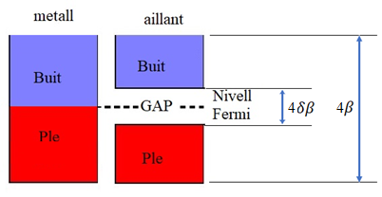

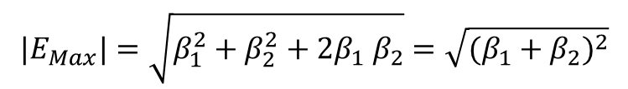
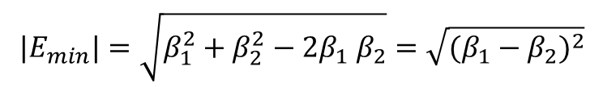
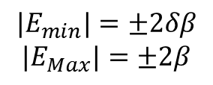
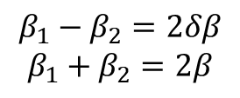
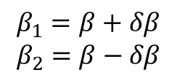
$$E_{±}=±\sqrt{β_{1}^{2}+β_{2}^{2}+2β_{1} β_{2}\cos{ka′}}$$
$${|E}_{min}|=\sqrt{β_{1}^{2}+β_{2}^{2}−2β_{1} β_{2}}=\sqrt{{(β_{1}−β_{2})}^{2}}$$
$${|E}_{Max}|=\sqrt{β_{1}^{2}+β_{2}^{2}+2β_{1} β_{2}}=\sqrt{{(β_{1}+β_{2})}^{2}}$$
$$β_{1}=β+δβ$$
$$β_{2}=β−δβ$$
$$β_{1}−β_{2}=2δβ$$
$$β_{1}+β_{2}=2β$$
$${|E}_{min}|=±2δβ$$
$${|E}_{Max}|=±2β$$

Slide 16
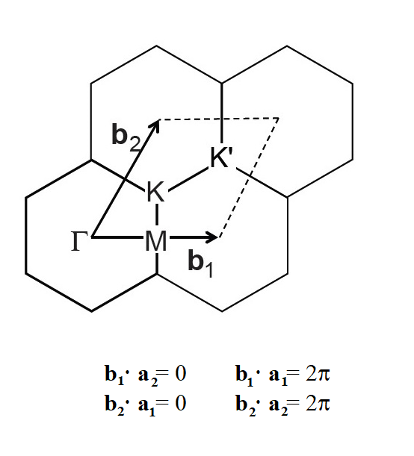
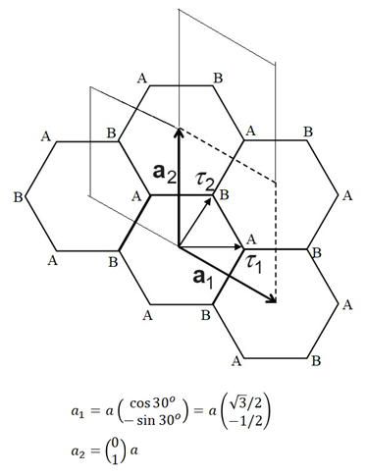

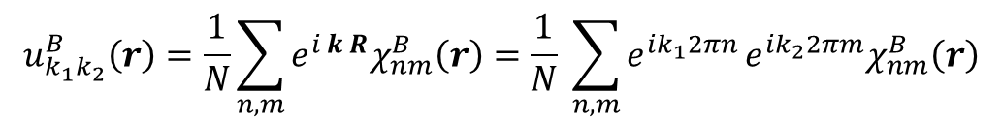
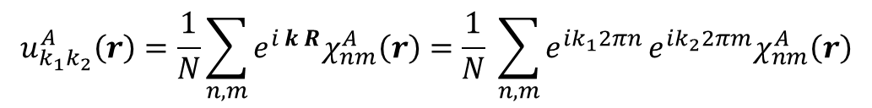




Hamiltonians Topològics 2D: el cas del Grafè
$$χ_{nm}^{A}\left(r\right)=χ_{A}\left(r−na_{1}−ma_{2}+τ_{1}\right)$$
$$χ_{nm}^{B}\left(r\right)=χ_{B}\left(r−na_{1}−ma_{2}+τ_{2}\right)$$
$$u_{k_{1}k_{2}}^{A}\left(r\right)=\frac{1}{N}\sum_{n,m}{e^{i k R}χ_{nm}^{A}\left(r\right)=\frac{1}{N} \sum_{n,m}{e^{ik_{1}2πn}}}e^{ik_{2}2πm}χ_{nm}^{A}\left(r\right)$$
$$u_{k_{1}k_{2}}^{B}\left(r\right)=\frac{1}{N}\sum_{n,m}{e^{i k R}χ_{nm}^{B}\left(r\right)=\frac{1}{N} \sum_{n,m}{e^{ik_{1}2πn}}}e^{ik_{2}2πm}χ_{nm}^{B}\left(r\right)$$
$$R=na_{1}+ma_{2}$$
$$a_{i}·b_{j}=2π δ_{ij}$$
$$k=k_{1}b_{1}+k_{2}b_{2}$$

Slide 17




$$H_{12}=〈χ_{00}^{B}\left|H\right|χ_{00}^{A}〉+〈χ_{00}^{B}\left|H\right|χ_{−10}^{A}〉+〈χ_{00}^{B}\left|H\right|χ_{01}^{A}〉$$
$$=〈χ^{A}\left|H\right|χ^{B}〉\left(1+e^{−i 2πk_{1}}+e^{i 2πk_{2}}\right)=β\left(1+e^{−i 2πk_{1}}+e^{i 2πk_{2}}\right)$$
$$H=\left[\begin{matrix}0 & H_{12} \\ H_{12}^{∗} & 0\end{matrix}\right]$$
$E_{±}^{2}=$ $H_{12}$ $H_{12}^{∗}$
$$H_{21}=H_{12}^{∗}$$
$$E_{±}^{2}=β\left(1+e^{−i 2πk_{1}}+e^{i 2πk_{2}}+e^{i 2πk_{1}}+1+e^{i 2π{(k_{1}+k}_{2})}+e^{−i 2πk_{2}}+e^{−i 2π({(k_{1}+k}_{2})}+1\right)$$
$=β \left[3+2 cos2πk_{1}+2cos2πk_{2}+2 cos2π\left(k_{1}+k_{2}\right)\right]$
$$E_{±}=± β \sqrt{3+2 cos2πk_{1}+2cos2πk_{2}+2 cos2π\left(k_{1}+k_{2}\right)}$$

Slide 18













$$E_{±}=± β \sqrt{3+2 cos2πk_{1}+2cos2πk_{2}+2 cos2π\left(k_{1}+k_{2}\right)}$$
$E_{±}=±{|H}_{12}$|
$±{|t}_{k}$|
$$\left[\begin{matrix}−E & t_{k} \\ t_{k}^{∗} & −E\end{matrix}\right]\left[\begin{matrix}1 \\ a\end{matrix}\right]=\left[\begin{matrix}0 \\ 0\end{matrix}\right]$$
$$a= \frac{E}{t_{k}}= \frac{±{|t}_{k}\text{| }}{t_{k}}$$
$$E=a t_{k}$$
$$E={|t}_{k}\text{|}\text{=0}$$
$$Ψ_{+}=N\left[\begin{matrix}1 \\ \frac{{|t}_{k}\text{| }}{t_{k}}\end{matrix}\right]=\frac{1}{{|t}_{k}\text{|}\sqrt{2}}\left[\begin{matrix}t_{k} \\ {|t}_{k}\text{|}\end{matrix}\right]$$
$$Ψ_{−}=\frac{1}{{|t}_{k}\text{|}\sqrt{2}}\left[\begin{matrix}−t_{k} \\ {|t}_{k}\text{|}\end{matrix}\right]$$
$$\left[\begin{matrix}0 & 0 \\ 0 & 0\end{matrix}\right]\left[\begin{matrix}a \\ b\end{matrix}\right]=\left[\begin{matrix}0 \\ 0\end{matrix}\right]$$
$$\left[\begin{matrix}a \\ b\end{matrix}\right]$$

Slide 19











Rodalies del punt K
$$k=K+q$$
$$|q|≪|K|$$
$e^{−ik{·a}_{1}}=e^{−iK{·a}_{1}}$ $e^{−iq{·a}_{1}}≈e^{−i 2π\frac{1}{3}} \left(1−i q{·a}_{1}\right)$
$$x=\frac{a_{1}+a_{2}}{|a_{1}+a_{2}|}$$
$e^{ik{·a}_{2}}=e^{iK{·a}_{2}}$ $e^{iq{·a}_{2}}≈e^{i 2π\frac{1}{3}} \left(1+i q{·a}_{2}\right)$
$$y=\frac{a_{1}−a_{2}}{|a_{1}−a_{2}|}$$
$$a_{1}= \left[\begin{matrix}\sqrt{3}/2 \\ −1/2\end{matrix}\right]a$$
$$a_{2}= \left[\begin{matrix}0 \\ 1\end{matrix}\right]a$$
$$x= \left[\begin{matrix}\sqrt{3}/2 \\ 1/2\end{matrix}\right]$$
$$y= \left[\begin{matrix}1/2 \\ −\sqrt{3}/2\end{matrix}\right]$$
$$q{·a}_{1}=q_{x} a \left(\begin{matrix}\sqrt{3}/2 & 1/2\end{matrix}\right)\left(\begin{matrix}\sqrt{3}/2 \\ −1/2\end{matrix}\right)+q_{y} a \left(\begin{matrix}1/2 & −\sqrt{3}/2\end{matrix}\right)\left(\begin{matrix}\sqrt{3}/2 \\ −1/2\end{matrix}\right)=q_{x} a\frac{1}{2}+q_{y} a\frac{\sqrt{3}}{2}$$
$$q{·a}_{2}=q_{x} a \left(\begin{matrix}\sqrt{3}/2 & 1/2\end{matrix}\right)\left(\begin{matrix}0 \\ 1\end{matrix}\right)+q_{y} a \left(\begin{matrix}1/2 & −\sqrt{3}/2\end{matrix}\right)\left(\begin{matrix}0 \\ 1\end{matrix}\right)=q_{x} a\frac{1}{2}−q_{y} a\frac{\sqrt{3}}{2}$$

Slide 20













$$t_{k}=β\left(1+e^{−ik{·a}_{1}}+e^{ik{·a}_{2}}\right)$$
$$q{·a}_{1}=q_{x} a\frac{1}{2}+q_{y} a\frac{\sqrt{3}}{2}$$
$$t_{k}=−\frac{\sqrt{3}}{2}a β\left(q_{x}−iq_{y}\right)$$
$$t_{k}^{∗}=−\frac{\sqrt{3}}{2}a β\left(q_{x}+iq_{y}\right)$$
$$q{·a}_{2} =q_{x} a\frac{1}{2}−q_{y} a\frac{\sqrt{3}}{2}$$
Coordenades polars
$$\left|q\right|,φ$$
$H=\left[\begin{matrix}0 & t_{k} \\ t_{k}^{∗} & 0\end{matrix}\right]=−\frac{\sqrt{3}}{2}$ $a β\left[\begin{matrix}0 & q_{−} \\ q_{+} & 0\end{matrix}\right]=−\frac{\sqrt{3}}{2} a β |q_{±}|\left[\begin{matrix}0 & e^{−iφ} \\ e^{iφ} & 0\end{matrix}\right]$
$$Ψ_{±}=\frac{1}{\sqrt{2}}\left[\begin{matrix}±e^{iφ} \\ 1\end{matrix}\right]$$
$$∇=\left(\begin{matrix}∂_{|q_{+}|}, & \frac{1}{|q_{+}|}∂_{φ}\end{matrix}\right)$$
$A_{k}=A_{φ}=i 〈Ψ_{+}|\frac{1}{|q_{+}|}∂_{φ}Ψ_{+}〉=\frac{i}{|q_{+}|}$ $\frac{1}{\sqrt{2}}\left(\begin{matrix}e^{−iφ} & 1\end{matrix}\right)$ $\frac{1}{\sqrt{2}}\left(\begin{matrix}ie^{iφ} \\ 0\end{matrix}\right)=−\frac{1}{2|q_{+}|}<0$
$$A_{k}=i 〈Ψ_{+}|∇ Ψ_{+}〉$$
$$A_{φ}=\frac{1}{2|q_{+}|}>0$$
al punt K’
$$\oint{A_{k}·dr}=\int_{0}^{2π}{A_{φ}|q_{+}|dφ}=−π<0$$
al punt K’
$$π>0$$
Topologia marginal

Slide 21
J.Planelles,
"A brief note in the form of a decalogue about Berry phase, Chern number, curvature, topological Hamiltonians and much more ... an outline for beginners“
Research Gate, 2018: DOI: 10.13140/RG.2.2.13602.73923

Slide 22





Lieb lattice or “Perovskite 2D”

Slide 23

Perovskite (3D)

Slide 24












Slide 25


Slide 27






Slide 28





Slide 29


Slide 33
Time reversal and Kramers theorem
In the absence of spin orbit interactions, Kramers' degeneracy is simply the
degeneracy between up and down spins which is fulfilled automatically in
the absence of a magnetic field.
If there are electronic states bound to the edges (or surface in the case
of a 3D topological insulator), then Kramers' theorem requires they be at least twofold degenerate at the T invariant momenta. If there is only one state available for each spin, then opening a gap necessarily violates Kramers' theorem.
We build topologically nontrivial insulating phases when spin-orbit coupling is introduced and gapless states remain.
You do not need SOC to get topological order. However, SOC is indeed a necessary ingredient in HgTe and many other materials which have so far been experimentally confirmed as topological insulators.

Slide 34



