Slide 1

1.RADIATION
J. Planelles

Slide 2


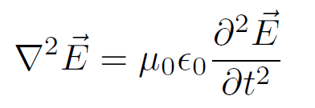
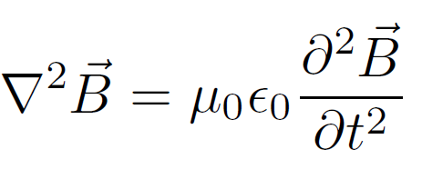
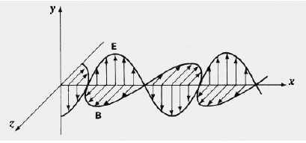


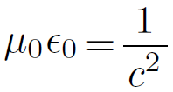

Slide 3



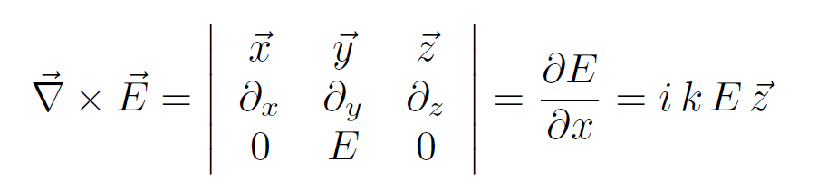


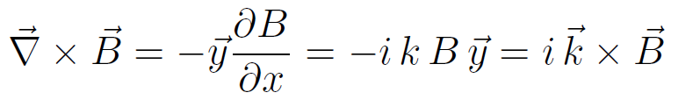

Slide 4



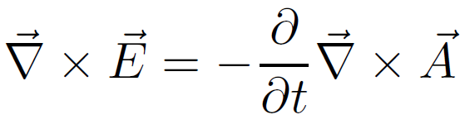

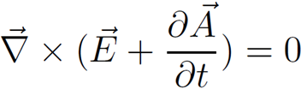
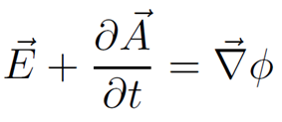

Slide 5
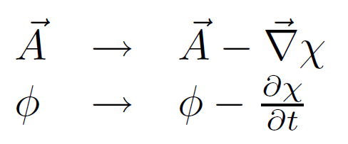
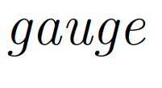


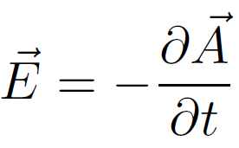

Slide 6




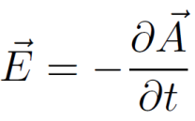



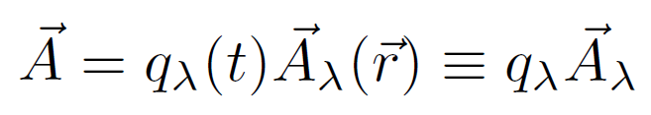

Slide 7
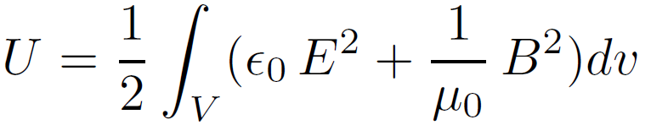




Slide 8



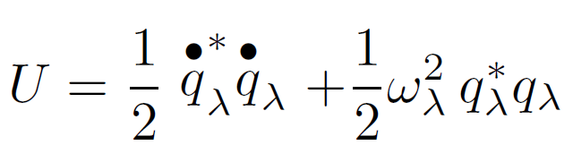

Slide 9


Slide 10
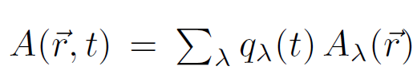




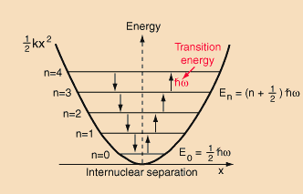
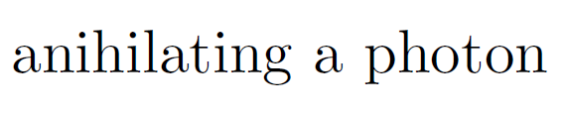



Slide 11
2.Matter and Field
J. Planelles

Slide 12

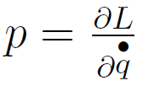
Classical Mechanics: an overview
Newton’s Law
Conservative systems
Lagrange
equation

Slide 13

Velocity-dependent potentials
Time-independent field
No magnetic monopoles

Slide 14

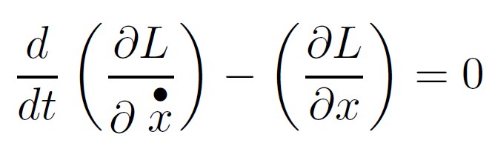
Velocity-dependent potentials: cont.
Define:

Slide 15
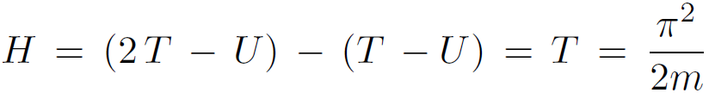
Velocity-dependent potentials: cont.
kinematic momentum:
canonical momentum:
Hamiltonian:

Slide 16
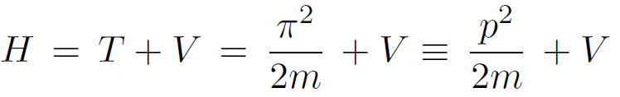
Conservative systems: V(x,y,z) & L = T - V
canonical momentum:
kinematic momentum:
Hamiltonian:

Slide 17


Gauge
;
We may select χ :
Coulomb Gauge :

Slide 18
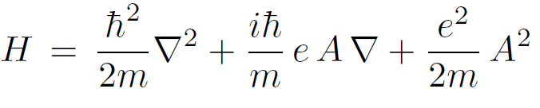
Hamiltonian (coulomb gauge)
;

Slide 19
Magnetic field: summary
No magnetic monopoles:
vector potential
No conservative field:
velocity-dependent potential:
Lagrangian:
kinematic momentum
Canonical
momentum:
Hamiltonian:
Coulomb gauge:
Hamiltonian operator:
Notes:
El modelo de Govorov es de 1B: no incluye transiciones a LHs

Slide 20
3. Electron-photon interaction
(selection rules and resonanace)
J. Planelles

Slide 21
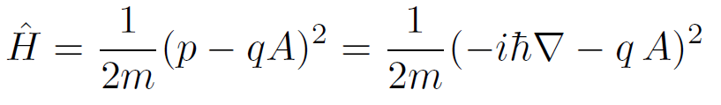
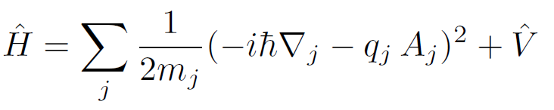


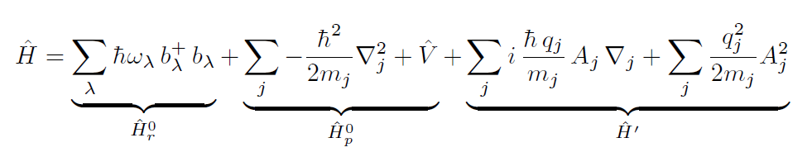
Hamiltonian of a charge in an electromagnetic field
Set of charges {q_{i}}:

Slide 22


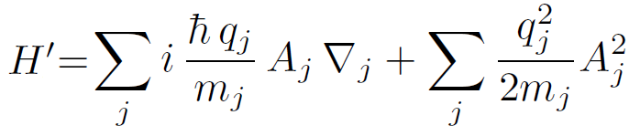

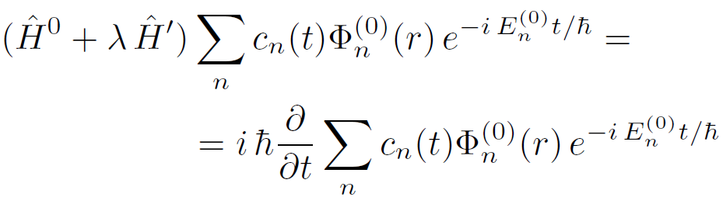
Time-dependent perturbation theory

Slide 23

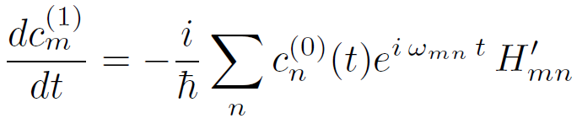

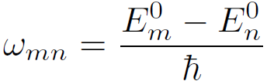
Time-dependent perturbation theory (cont.)
Transition probability:
Taylor expansion:

Slide 24


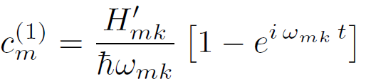
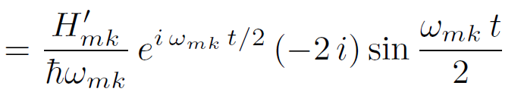
Time-dependent perturbation theory (cont.)

Slide 25


Time-dependent perturbation theory (cont.)
resonance:
resonance:
selection rule:

Slide 26
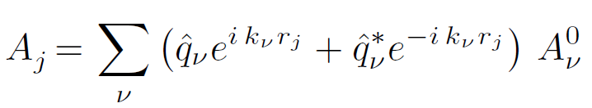
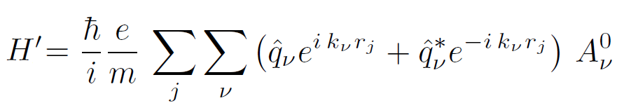
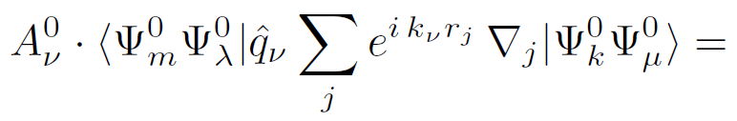
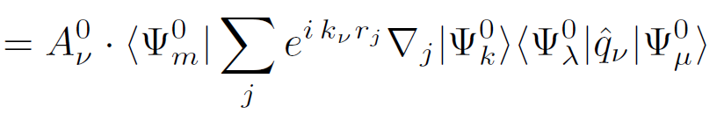

Time-dependent perturbation theory (cont.)
First (and larger) perturbation term:
(with q = - e, m of electron)
Integral involved:
Single photon transition
Spontaneous emission

Slide 27



Time-dependent perturbation theory (cont.)
After some algebra:

Slide 28
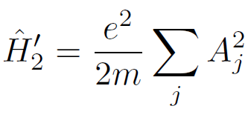
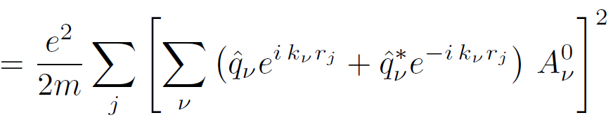

Time-dependent perturbation theory (cont.)
Second (smaller)
perturbation term:
(q = - e, m of electron)
terms : two-photon transitions
two-photon transitions: weak (→use LASER). e.g. Raman

